Slide 1
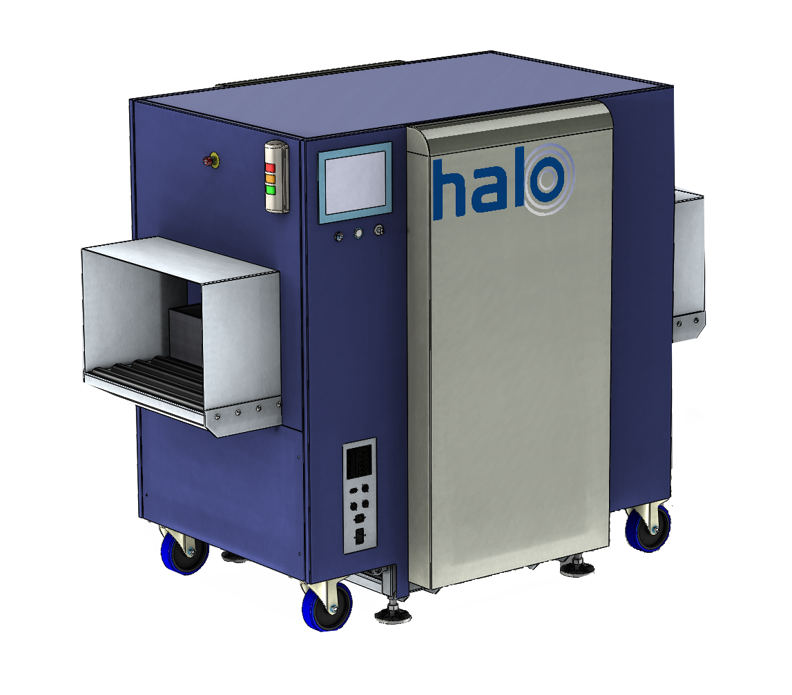
HALO X-ray Technologies Ltd
Protecting people and infrastructure
Automating the checkpoint using an integrated XRD threat resolver
ADSA21 - Effective Integrated Systems
http://haloxray.com
The research in this presentation was conducted under contract with the U.S Department of Homeland Security (DHS) Science and Technology Directorate (S&T), contract #70RSAT18CB0000038. The opinions contained herein are those of the contractors and do not necessarily reflect those of DHS S&T.
Simon Godber
CEO
E: sxg@haloxray.com
T: +44 (115) 860 2236

Slide 2
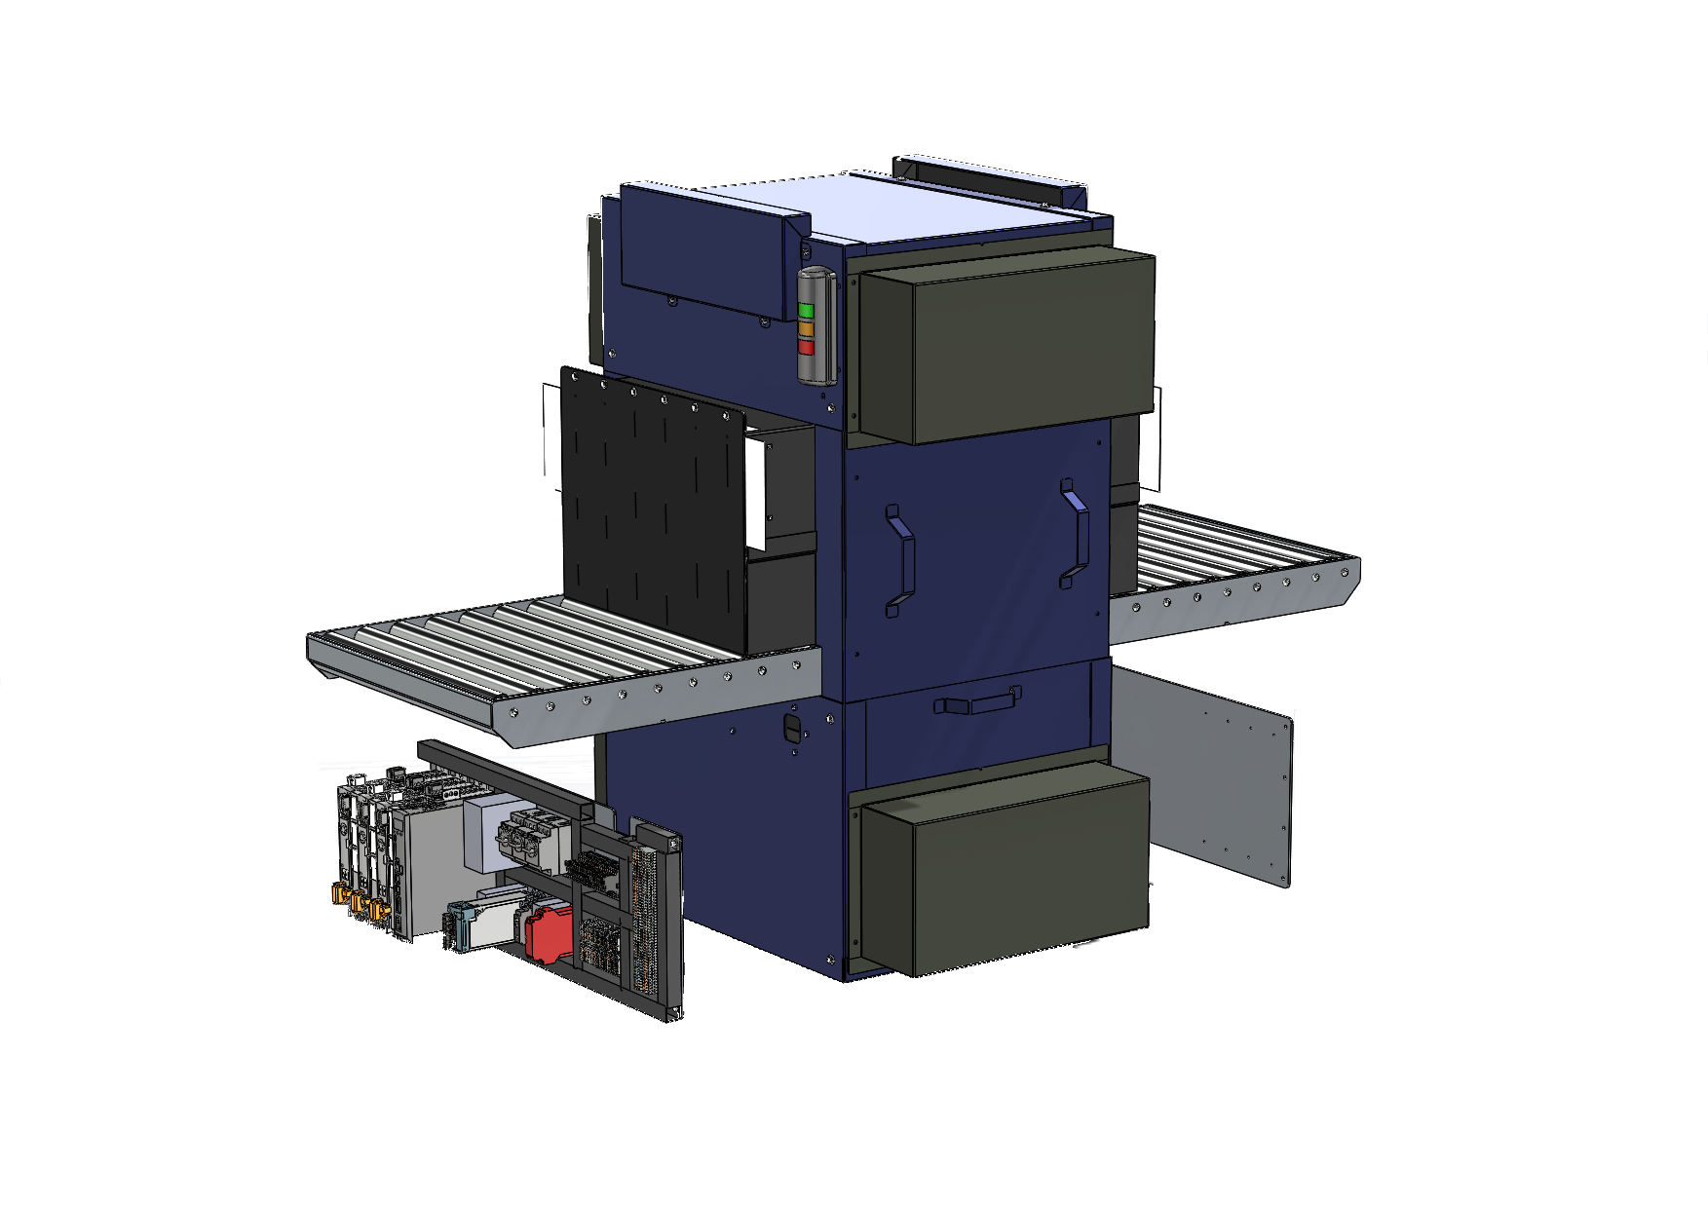
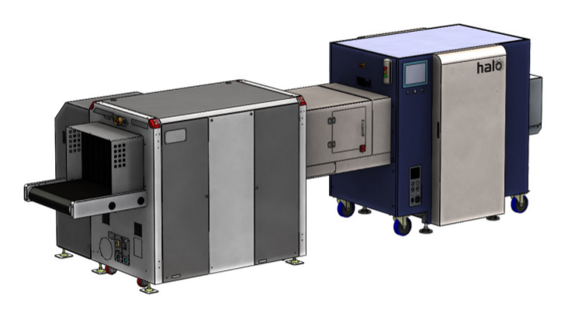
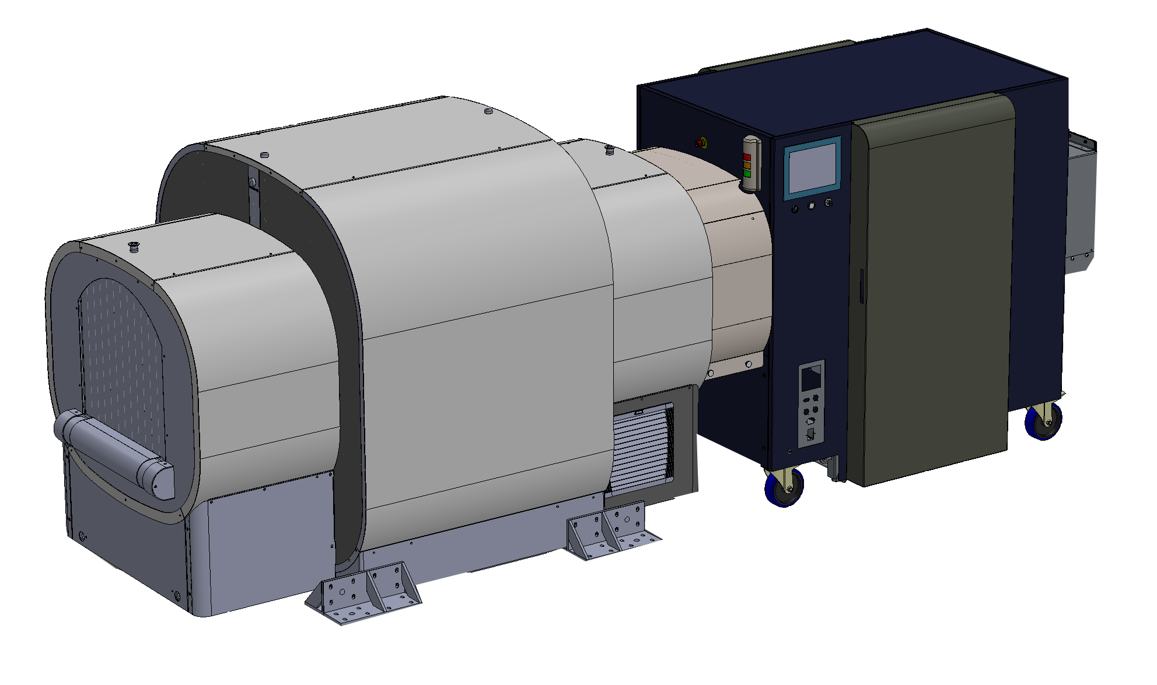
So what? Who cares?
Space: Checkpoint, checked, CBP, borders
Problem: Realizing an automated checkpoint at operationally viable PFA
Solution: HALO XRD OEM & standalone solutions
HXT264, HXT364, HXT464, HXT2108
Self-contained XRD scanning hardware
Standard components – low cost & high MTBF
Combination with existing prescreeners
Development of new closely integrated solutions
Open architecture interface
Results: depends on the prescreener
CT/HXT264: aggregate ~1.5% PFA
AT/HXT264: ongoing (~8% PFA)
Operations: currently built and deployed
AMS for stream-of-commerce
TSL for explosives data collection
Integration with L3Harris ClearScan, Rapiscan 620DV
TRL: 7 moving to 8 and certification
Contact:
Commercial: Simon Godber / sxg@haloxray.com
Science: Anthony Dicken / ad@haloxray.com
Telephone: +1 (844) 898 6466 / +44 (115) 860 2236
Website: https://www.haloxray.com/

Slide 3
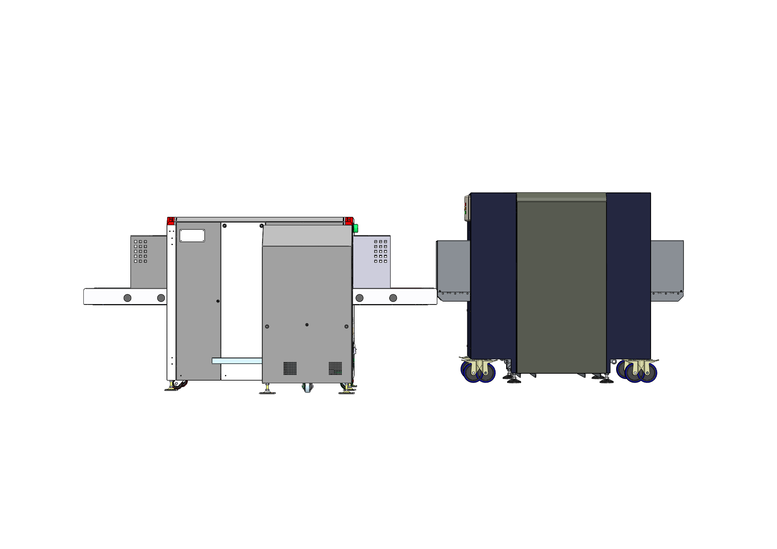
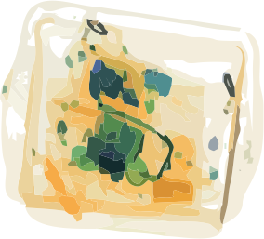
Current CONOPS
DICOS
Database
Automatic (no user interaction)
Prescreener required to create DICOS targeting information
HXT264 analyzes target area and appends DICOS
DICOS to local/remote store
GUI displays information from DICOS DB
GUI output is optional

Slide 4
Future CONOPS
Ideal data:
Density
Mass
Zeff
DE
Location
Shape
XRD
HXT464 (CT/XRD)
CT available data:
Density
Mass
Zeff
DE
Location
Shape
Opportunities:
Feed-forward
Compound ATR
Significantly improved PFA
Automated checkpoint

Slide 5
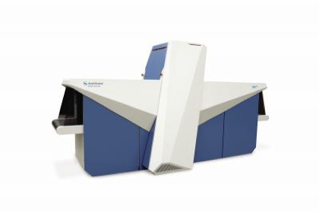
Current XRD systems
Multi-emitter
X-ray generator
Morpho XDi™
(Images courtesy of Morpho Detection)
Multiple detectors
HXT approach
X-ray tunnel
HALO advantages:
Reduced complexity (single generator & detector)
Reduced cost
COTS components - better MTBF
Smaller footprint
Dependencies:
Some moving parts
Relies on a pre-screener
400
600

Slide 6
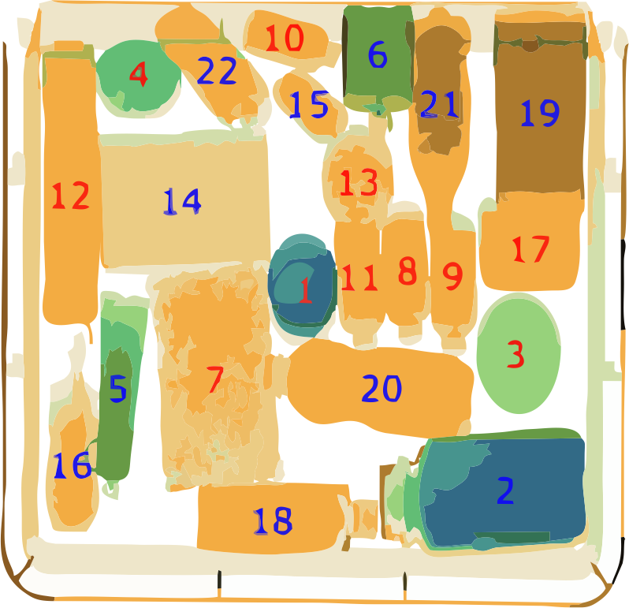
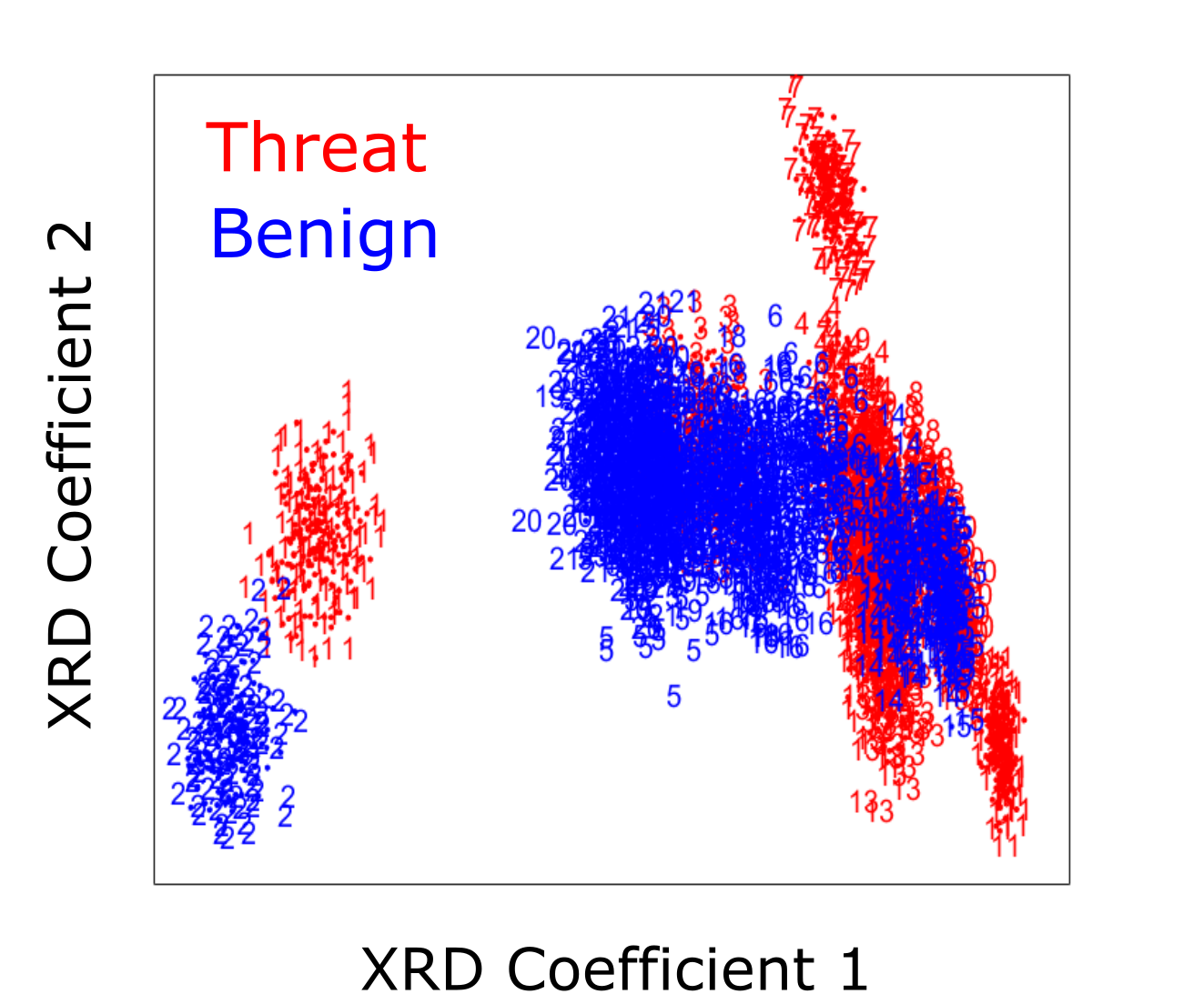
Example – XRD only

Slide 7
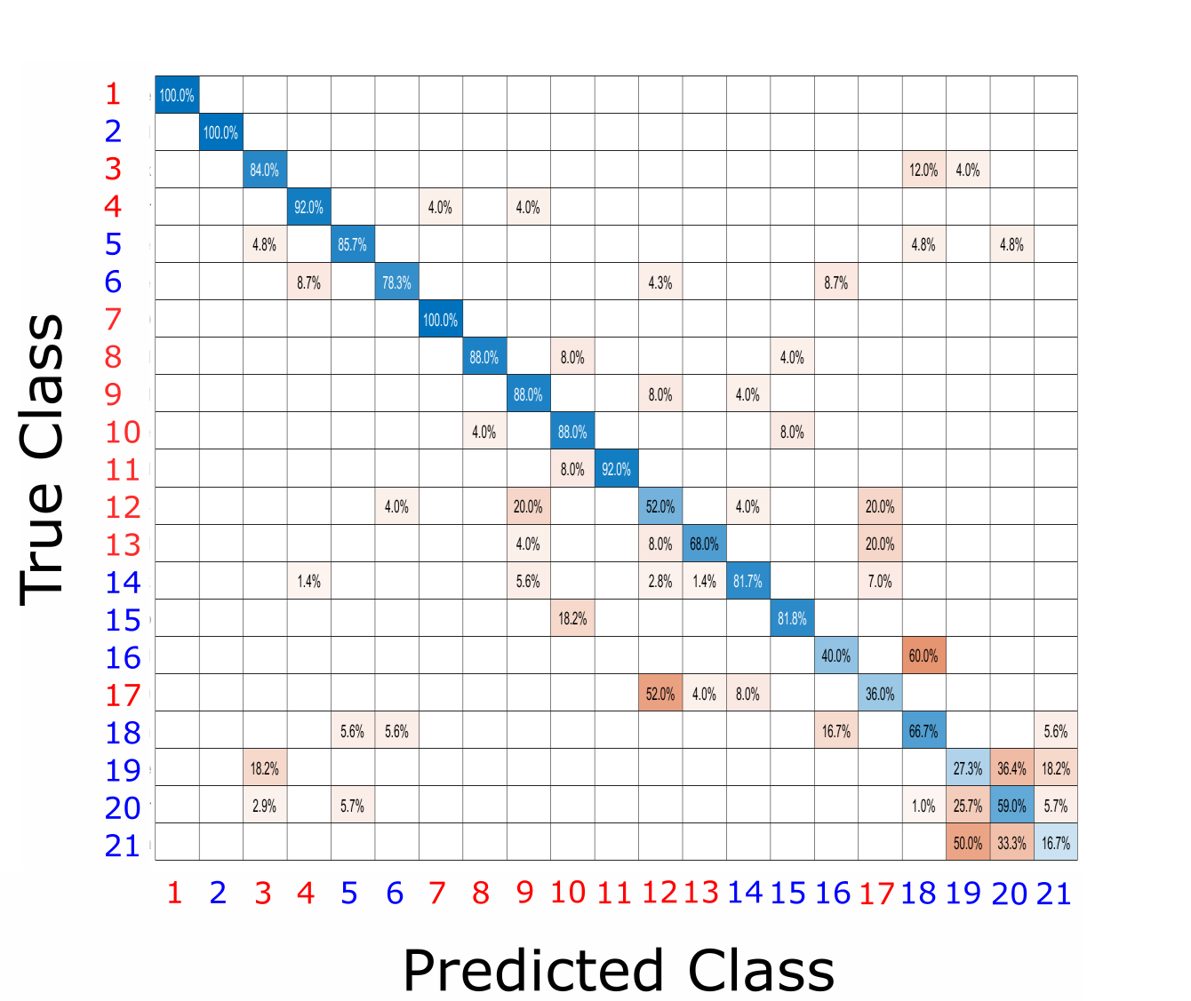
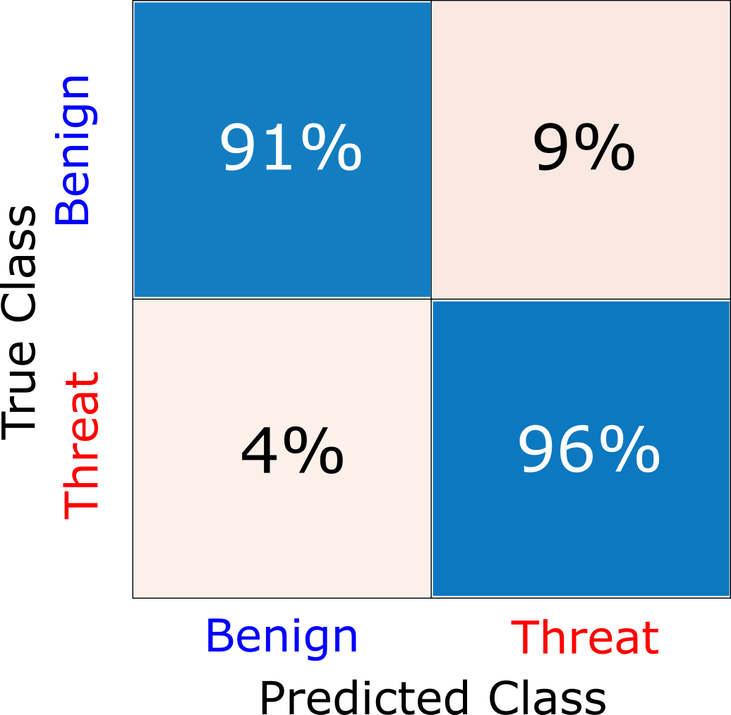
Example – XRD only

Slide 8
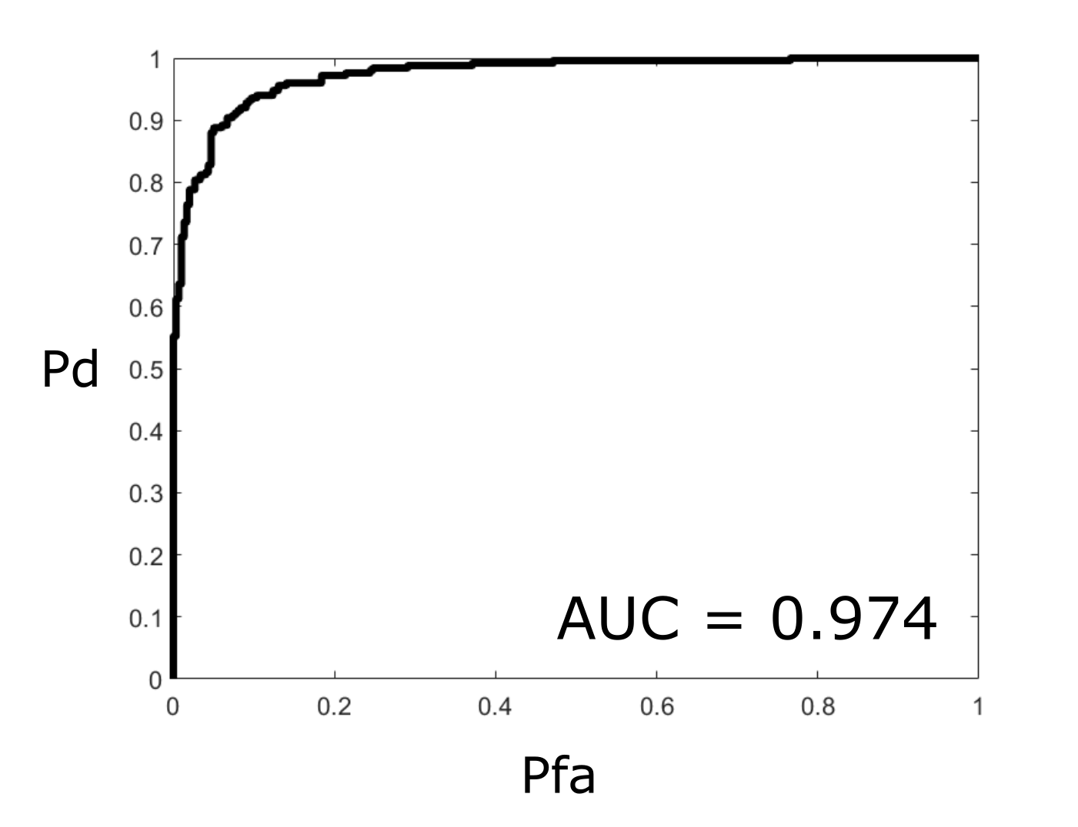
Example – XRD only

Slide 9
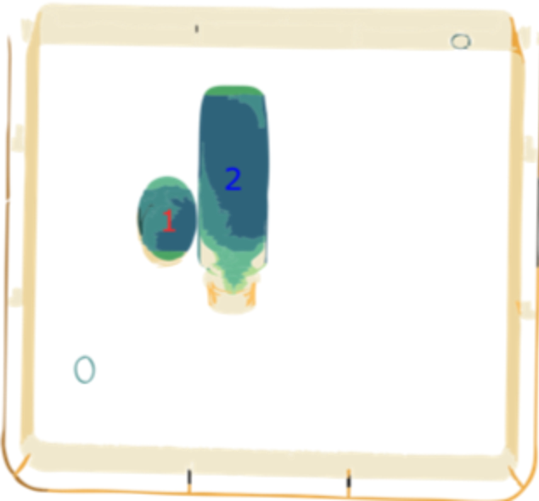
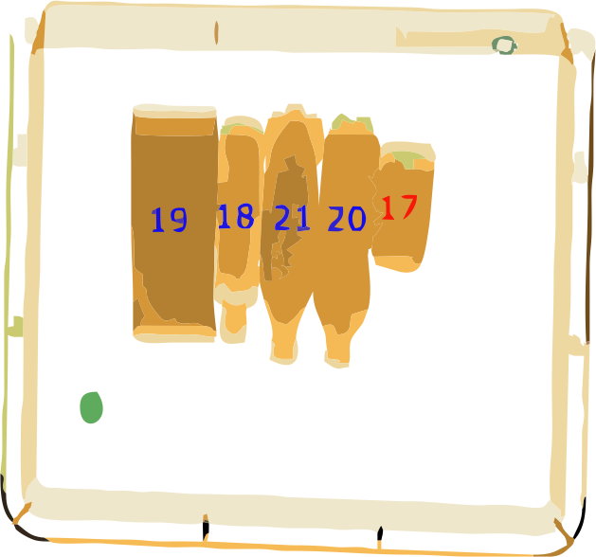
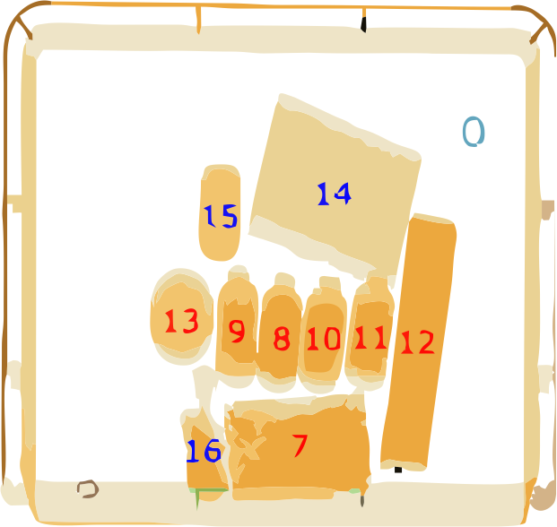
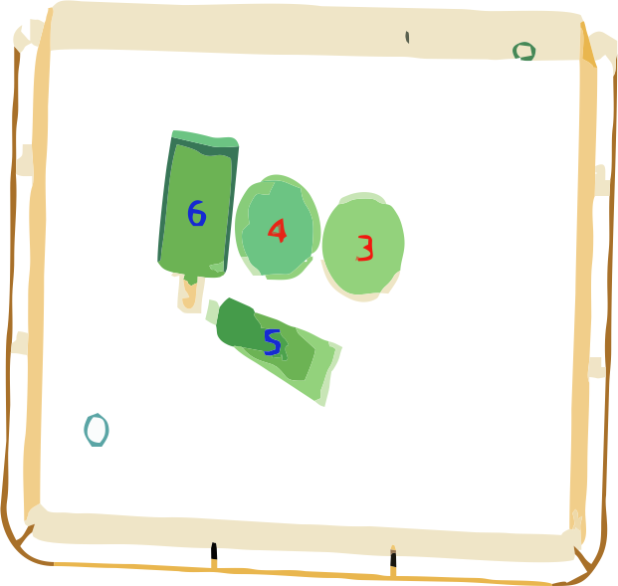
Example – DE/XRD

Slide 10
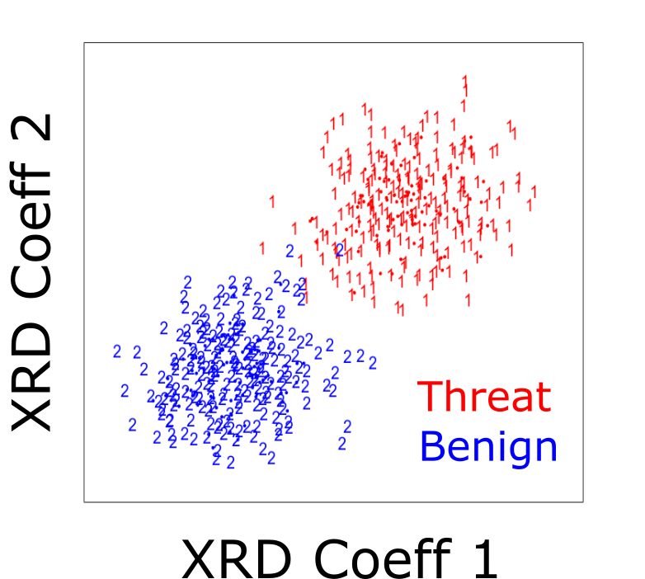
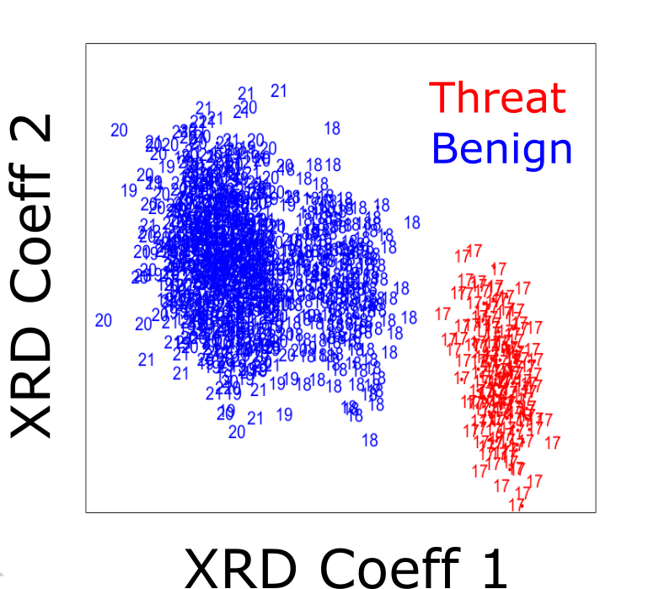
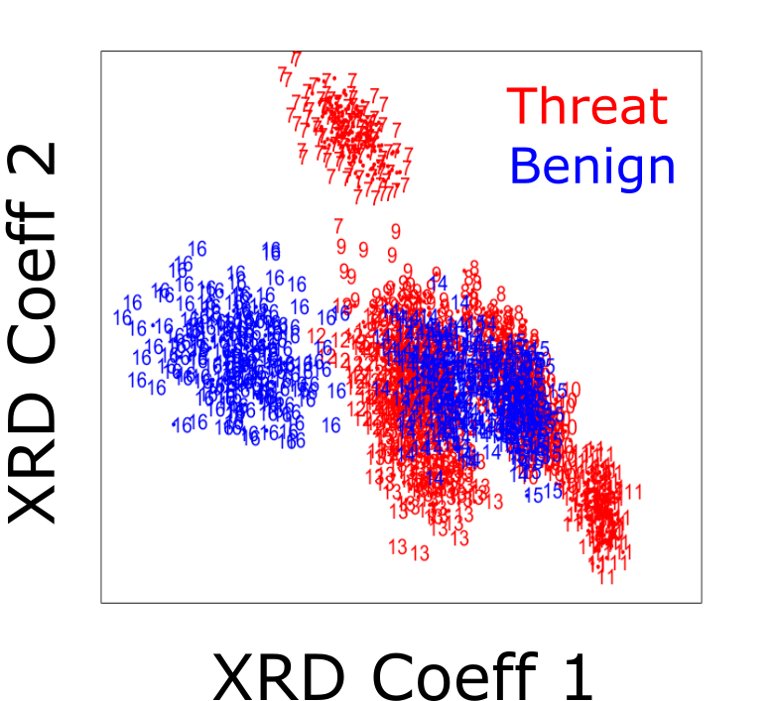
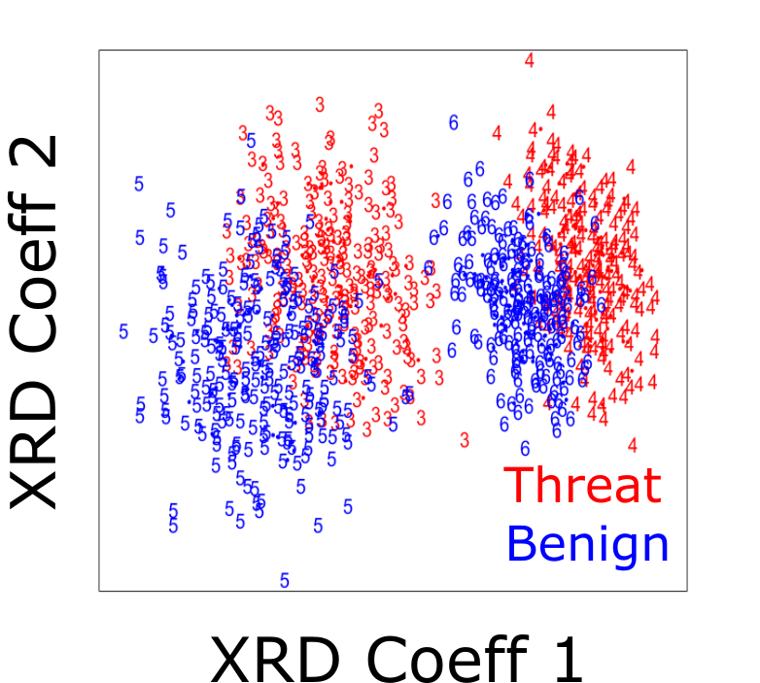
Example – DE/XRD

Slide 11
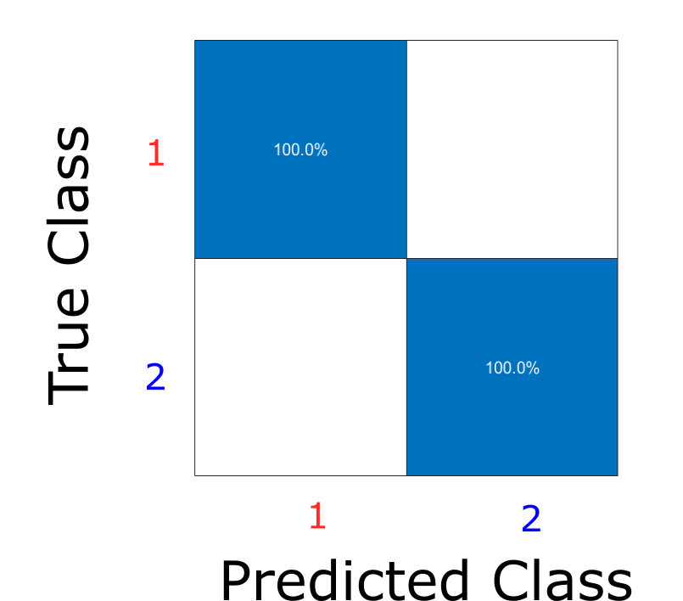
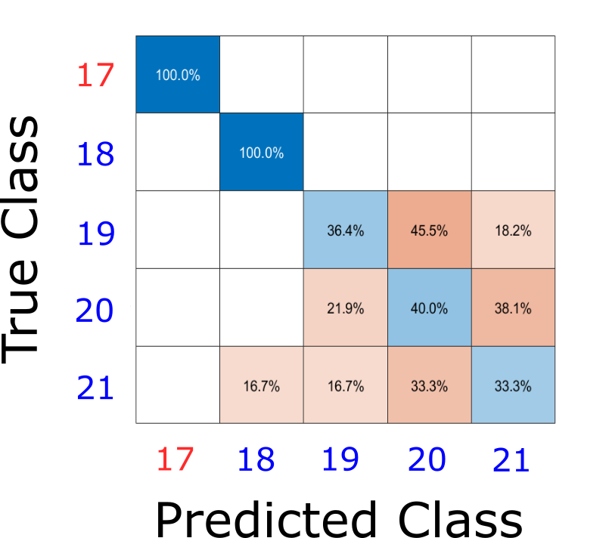
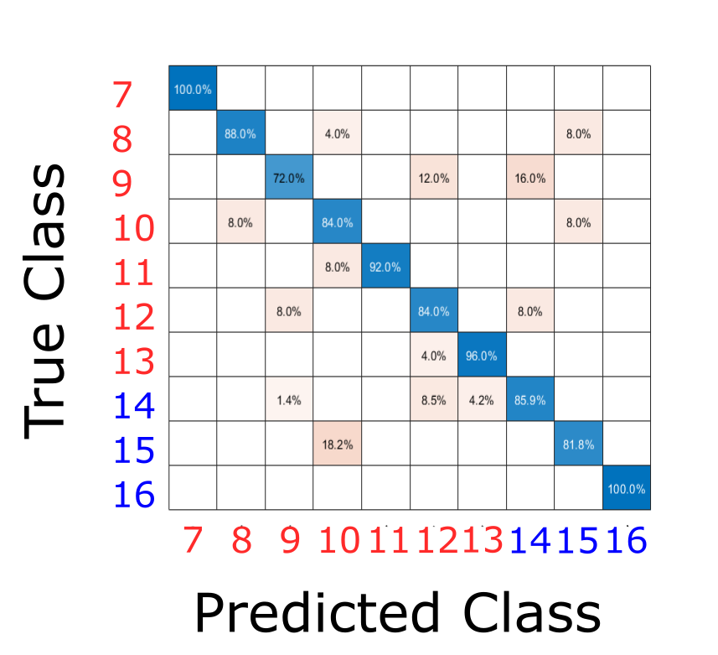
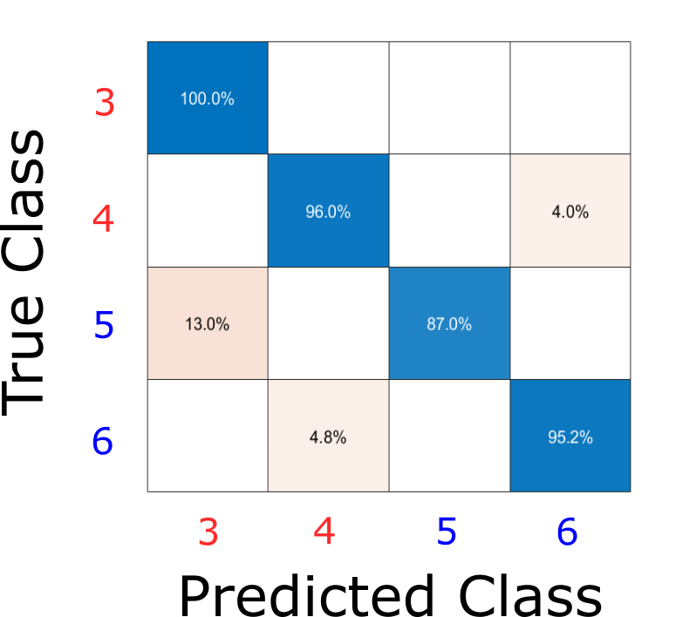
Example – DE/XRD

Slide 12
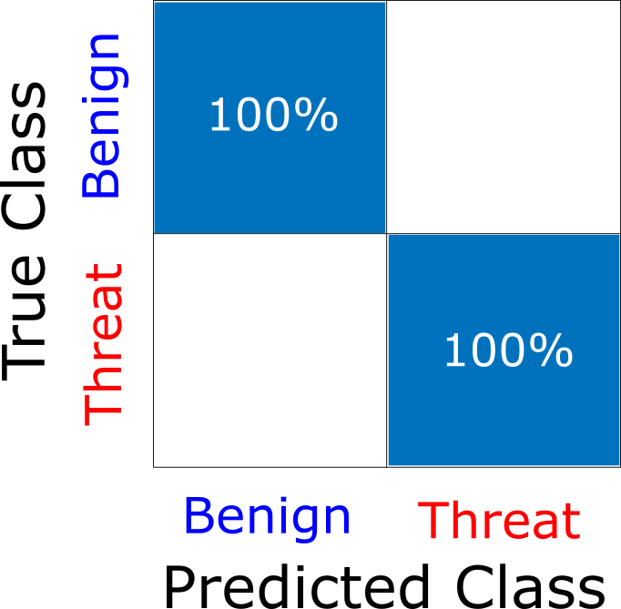
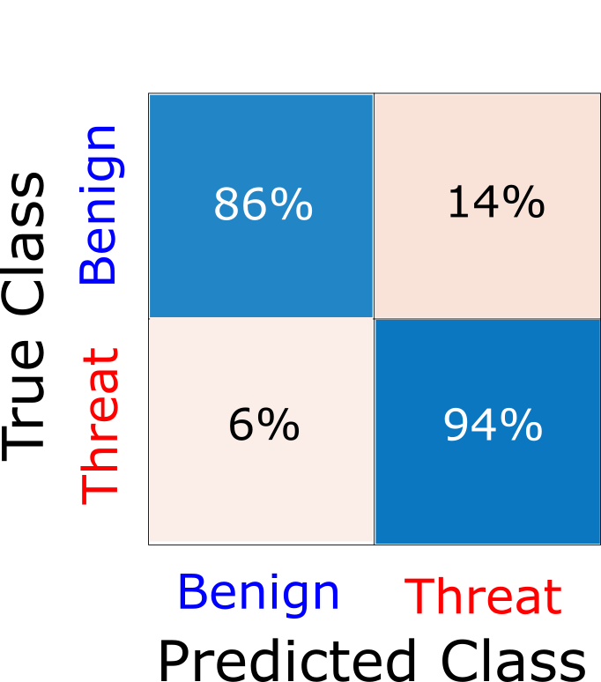
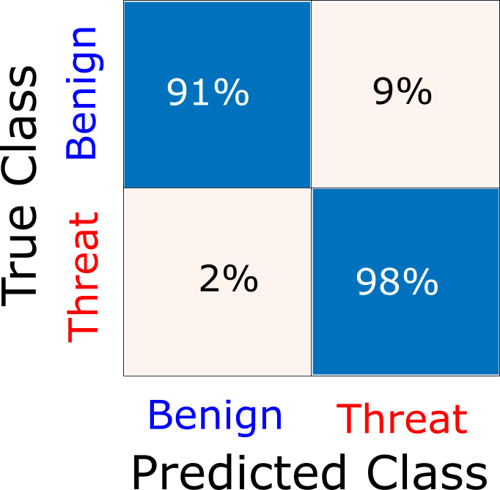
Example – DE/XRD

Slide 13
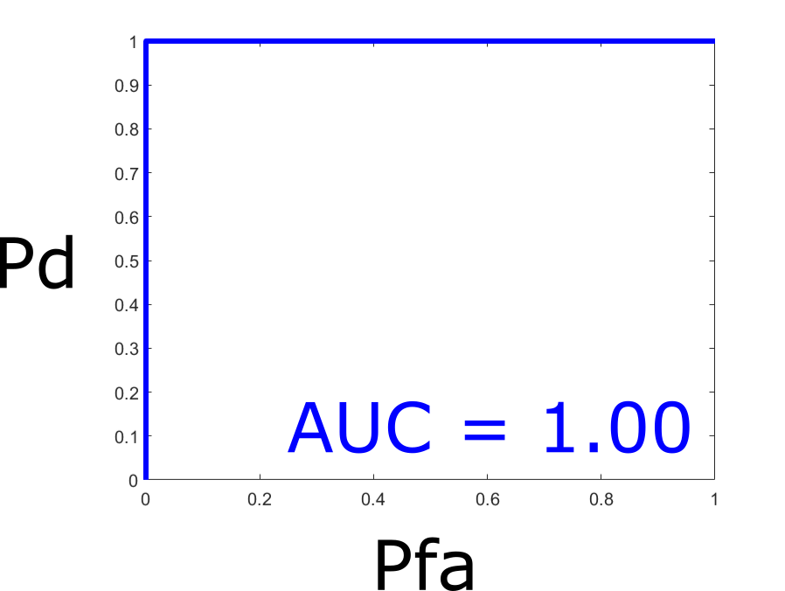
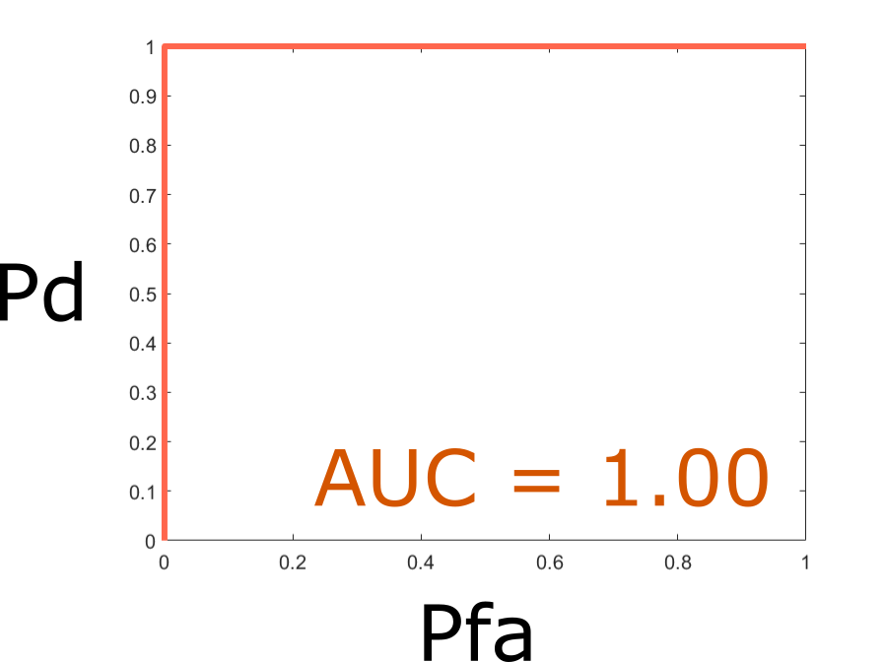
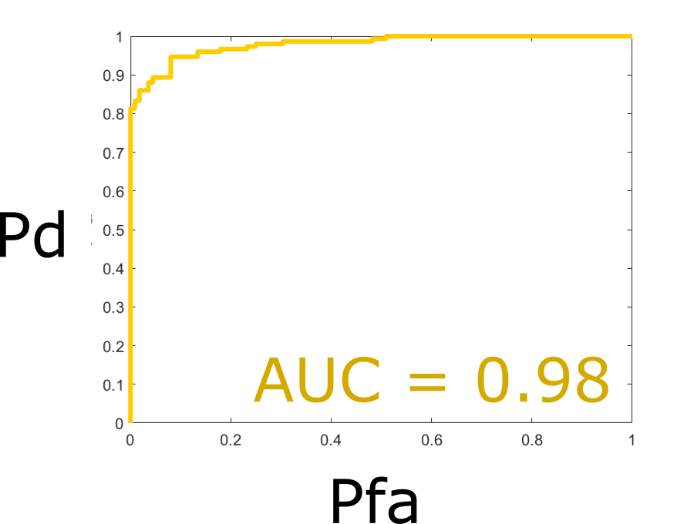
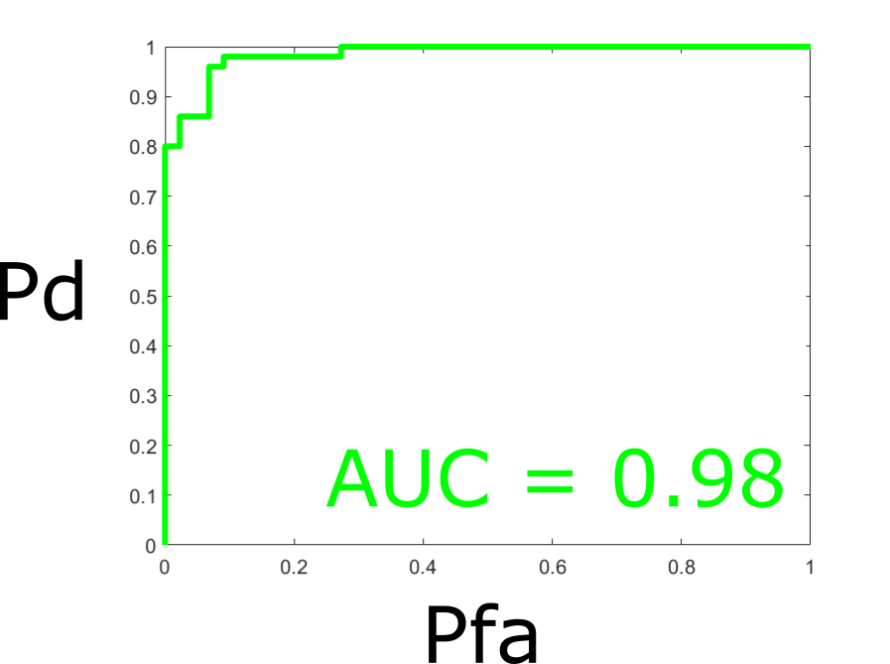
Example – DE/XRD

Slide 14
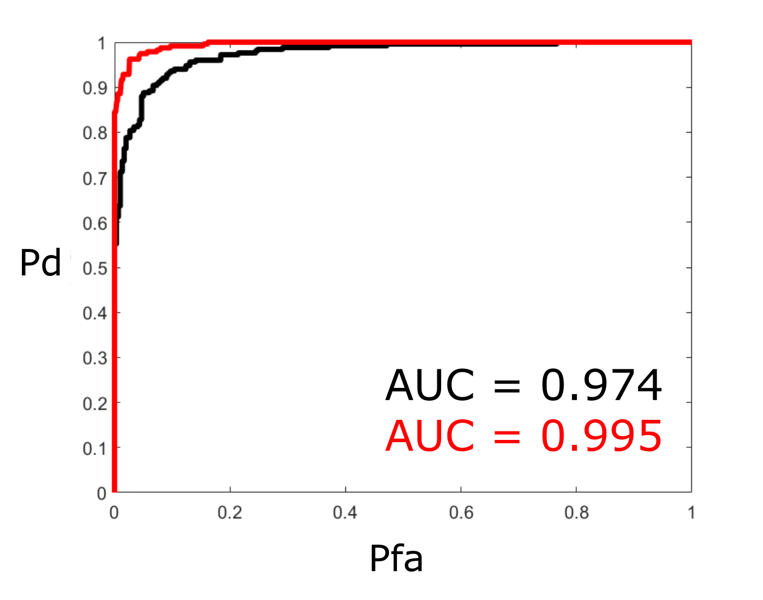
Example – DE/XRD

Slide 15
HALO X-ray Technologies Ltd
Biocity Nottingham, Pennyfoot Street, Nottingham, NG1 1GF
CEO: Simon Godber
sxg@haloxray.com
http://haloxray.com
google.com/+Haloxray
www.linkedin.com/company/halo-x-ray-technologies-ltd
twitter.com/haloxray

