Slide 1
ATR Initiative (Task Order 4): Technical Kickoff Meeting
August 22, 2013
Revised, October 9, 2013
Revised, October 10, 2013
Revised, November 4, 2013
Revised, December 16, 2013

Slide 2
Bottom Line
Develop automated target recognition (ATR) algorithm to detect targets in scans on a medical CT scanner
Input = 3D CT data + projections
Output = 3D label image (i.e., a “mask”) indicating pixels of detected targets
Targets
Saline, modeling clay, rubber sheets
Detection of objects in ATRs
Defined in terms of recall and precision
Determined using a ground truth label image
Scoring of ATRs
Probability of detection (PD) > x%
Probability of false alarm (PFA) < y%
TBD function of PD and PFA (F-score?)
PD and PFA may be defined per object, not per bag/target
Notes:
What about pseudo-targets as mentioned in overview?
Are the targets limited to the three listed here?
Do the rubber sheets alarm on the present EDSs?
Pd and Pfa may be defined per object, not per bag/target. This is different from the TSL scoring, why?

Slide 3
Bottom Line (II)
Prior art methods are proprietary and classified
Will not know if results are better
Success
Understanding ATR problem
Being able to work with suppliers in the future
Solving detecting difficult cases more important than trying to detect easy cases
Sample ATR, scoring programs will be supplied to reduce development efforts
Bibliography supplied of prior art
Notes:
How will it be known if the developed ATRs are better than OEMs?
Explain “Understanding the ATR problem” as “Success”. Is this for the PIs, or for all involved?
“Suppliers” . Do you mean third parties and OEMs?
How are difficult cases defined? This needs to be done as soon as possible.
Should be noted in the slide that the prior art in the Bibliography may not be presently applied.
Is an improvement of the bibliography prior art acceptable? Is a combination of multi methods acceptable?

Slide 4
Vernacular
ATR (automated target recognition) = ATD (automated target detection)
Targets = objects of interest
Project names
ATR project or initiative
Task Order 4 (TO4)

Slide 5
Team - PIs
ATR
Charlie Bouman – Purdue University
Synho Do – Massachusetts General Hospital
Jens Gregor – University of Tennessee
Jun Zhang – University of Wisconsin, Milwaukee
Data collection
Doug Boyd, Telesecurity Sciences
Rick Moore, Alyssa White, Massachusetts General Hospital
Tools and ground truth
Franco Rupcich, Independent consultant
Technical leadership
David Castanon, Clem Karl, Boston University
Carl Crawford, Csuptwo
Harry Martz, Lawrence Livermore National Laboratory
Programmatic leadership
Michael Silevitch, John Beaty, Northeastern University/ALERT

Slide 6
ATR Definition
Input to ATR: 3D CT images + projections
Objects are not segmented
Feature are not extracted
CT images:
Use supplied images
Do not reconstruction projections to create new images
Possible Functions: segmentation, feature extraction, CT correction, classification
Outputs from ATR: red/green light, label images, log file
Notes:
Input to ATR will be only what the EDS generates, 3-D images and 2-D projections.
What is in the “log file”?

Slide 7
ATR Implementation
Sample ATR will be supplied based on Karimi code for Segmentation Project
Demonstrate reading FITS images, writing label images and log files
Can rip out algorithm and insert your own
C/Linux
Execution time out of scope
Do not over-train on the data or use illegal features
Will have to discuss algorithms and training methods
Notes:
What version Linux? They are always not backward compatible.
Need to add 32-bit Operating System for Linux since all the software tools must execute under this OS.
Will the program accept an ATR that spends an hour per bag?
Need to identify illegal features. Also need to explain how to use certain features so they are not classified as illegal features.
“Over-train” is hard to control. This may need to be revisited in the near future.

Slide 8
ATR Overview (Prior Art)
Multi-Path
Segmentation
Feature
Extraction
CT
Correction
Classifier
Sheet filter/path
Bulk filter/path
Weapons filter/path
Mass
Density
Z-effective
Texture
Volume
Non-linear
thresholds
Orientation
Resolution
Do something other than prior art
Notes:
1. Is removing the sheet filter/path and bulk filter/path and having only one path the desired result?
8

Slide 9
Features (Prior Art)
Mass
Mean: LAC, Zeff
Standard deviation: LAC, Zeff
Histograms
Higher-order moments
Skew, kurtosis, entropy
Texture
Wavelets
Your responsibility to determine relevant features

Slide 10
Illegal Features
Shape (except for minimum sheet thickness)
Size
Orientation
Location
Maximum mass, volume
Container type
Will review your features during course of the project
Notes:
During the review, will need to know how illegal features are being applied to the ATR.

Slide 11
CT Artifacts
Finite and spatially dependent resolution
Streaks
Additive noise
Rings, bands
Low-frequency shading (cupping, dishing)
CT number shifts
Literature says artifacts reduce detection performance
Notes:
1. Will CTN boosting be allowed to correct for CT artifacts?

Slide 12
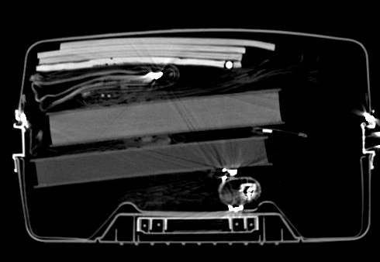
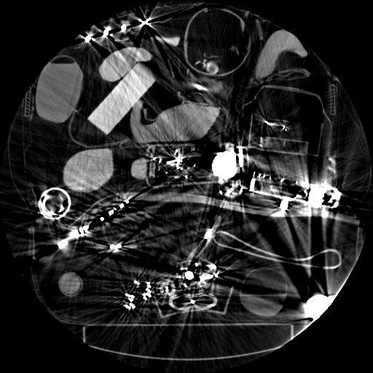
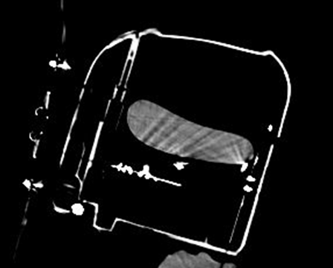
Sample CT Images

Slide 13
Label Images
Label Image: An image generated either by an ATR or by a ground truth generating program indicating to which label a pixel belongs
Label:
A set of non-zero pixels in an ATR label image indicating the presence of an alarm at the corresponding location in the physical bag/bin
A set of non-zero pixels in a ground truth (GT) label image indicating the presence of a target at the corresponding location in the physical bag/bin
The number of pixels in a label image is the same as in its corresponding CT image (Nx512x512)
A label image pixel can be assigned to only one object
Values:
0 = background
Label/tag for object for ground truth
>0 = object number from ATR
Does not have to match object tag
Notes:
1. Is there a desired direction for the labeling of the objects? Is it acceptable for the ATR to assign labels as objects are discovered?

Slide 14
Targets
Saline: ~1035 – 1150 MHU
Container not part of target; only the saline
Modeling (polymer) clay
Rubber sheers: ¼” thickness (minimum)
Minimum mass: 250 g (physical, not CT)
Maximum mass: none
Targets will not be split; they will be contiguous
Notes:
Will the container information be provided to the researchers?
Maximum mass can be the complete bag. Is there such a case scanned?

Slide 15
Pseudo Targets
Saline, clay, rubber sheets
125 g < mass < 250 g
Powders:
Density < 1 g/cc
Mass > 125 g
Sheets
< ¼” thick
Used to test lower mass and density thresholds
Will not count in PD or PFA calculations
Notes:
What is the advantage to the ATR for the detection of these pseudo targets if they are not going to be scored?

Slide 16
Packing
Targets packed with different
Shapes
Containers (not part of target)
Concealment
Clutter
Location
Orientation
An indication of level of difficulty of detection will be supplied
Targets will be scanned without clutter (bare) to show clean images
Notes:
Will the indication “of the level of difficulty of detection” be a visual image, a number assigned to the bag clutter or another parameter?

Slide 17
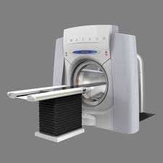
Scanning & Data Sets
Scan on Imatron medical CT scanner
Same scanner and protocol as reconstruction project
Single energy
Raw data collected, but not be used on this project
Date ~9/30
Scan spec distributed soon
Send feedback on what needed to scan
~200 scans
Ground truth will be created only for targets and pseudo targets, not for non-targets
Manually created to prevent CT artifacts from splitting objects
Use TO3 data for now
Notes:
Will false alarms be examined to determine if there is a correlation to the targets?
The splitting of objects does happen and does cause a problem. Why is this being omitted?

Slide 18
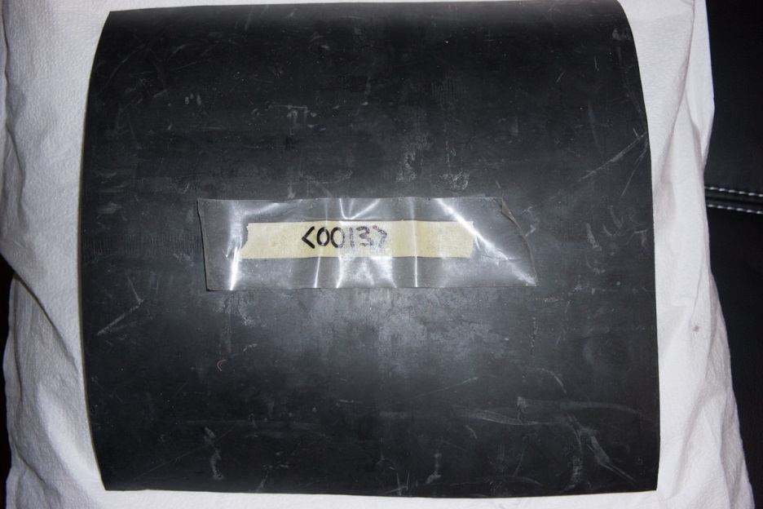
Database
CT scans
Ground truth
Information on packing
List of objects and characteristics (mass, size, etc.)
Pictures
Videos
Objects have IDs

Slide 19
ATR Testing
Run by performer at their site
Too difficult to execute at ALERT
Honor system not to over-train
Results scored by provided tools
PD/PFA
[optional] ROC area
Some indication of difficult cases
Notes:
1. The “tools” need to keep track of easy and difficult detection cases since this is the major area of interest.

Slide 20
Performance Metrics
PD > x, PFA < y
Values TBD
PD based on # targets scanned
PFA based on # bags scanned
TBD metric combining PD and PFA
Number of FAs/bag
[optional] area under ROC
PD
May be weighted for difficult cases
Report for each type of target and average
Notes:
Difficult cases should not be weighted but should be extracted from the data for further analysis.

Slide 21
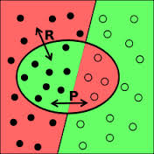
Detection and False Alarm
A detection occurs when an object declared by an ATR matches the ground-truth for a target. The term match is defined in terms of recall, R, and precision, P. Let G correspond to the set of pixels in the ground-truth for a target. Let S correspond to the set of pixels declared to be an object by at ATR. Then recall and precision are defined as follows.
$R=\frac{volume\left(G∩S\right)}{volume(G)}$
$P=\frac{volume\left(G∩S\right)}{volume(S)}$
For this project a detection occurs when R≥0.5 and P≥0.5.
May relax for all objects depending on accuracy of ground truth
Notes:
May relax P/R for all objects

Slide 22
More Performance Criteria
Minimize use of special cases (corner cases)
Feature space chopped up
Over-training
Extensible for new targets
Notes:
Revise statement about corner cases.
Are the new targets for TO4 or for future work?

Slide 23
File Formats
FITS (Flexible image transport system)
3D
CT images converted from DICOM to FITS
Code in C/Matlab written by Jens
http://fits.gsfc.nasa.gov/
Supported by Imagej

Slide 24
Support Functions (Tools)
Franco Rupcich coding in C
Sample ATR
Reading image
Writing results (label, log files)
Revised as necessary
Replace ATR functions with your own
Scoring software
Detection using recall/precision
PD/PFA
Simulated images for validation
Image conversion to FITS
Ground truth - Mevislab
Notes:
Will there be a bug report for the software?
What is meant by simulated images for validation?

Slide 26
Reasons for This Process
Detection requirements are classified
Data from deployed equipment are SSI or classified, and are under export control
There is no publicly available set of images that are representative of challenging ATR problems for explosive detection systems.
The business interests of the vendors should be protected
DHS/TSA policies do not allow TSL to test components (e.g., an ATR) separate from a complete scanner
There may be privacy concerns with scans on AIT equipment.
Notes:
Why bring up AIT since the presentation only discusses CT images?

Slide 27
Program Success
The program will improve ATRs. The improved target recognition may lead to decreased minimum target mass, increased target population coverage, increased probability of detection and decreased probability of false alarm.
The program will increase involvement of third parties via the availability of common CT datasets, and tools, which will increase the work in target recognition, and the number of students who can join the workforce of the vendors and DHS.
The program will foster collaboration between academics, national laboratory personnel and incumbent security industry vendors.
Notes:
How will it be known if the program will improve ATRs since the results cannot be tested against the original OEMs?
The students who can join the workforce may be limited.

Slide 28
ADSA – Task Order Linkage

Slide 29
Uniqueness
Bibliography and copies prior art provided
Patents, presentations, reports, articles
Vendors may be doing something else
Do not replicate prior art
Extend sample ATR
Notes:
1. Can prior art be improved?

Slide 30
Collaboration
Researchers encouraged to collaborate with other team members
Tools, image formats
Not on algorithms
Segmentation expertise from segmentation project
Notes:
1. Should there be a common location to store all the developed tools which could be used by other researchers?

Slide 31
Schedule
Contracts written for one year to ~8/2014
ALERT will request no cost extension from DHS to ~2/2015
Scanning on 9/30
Use TO3 data for now
~6 weeks before end of project
Technical interchange
Final reports due
Request constant progress
Notes:
1. How will constant progress be monitored?

Slide 32
Status Reporting
Monthly tele-conferences
First Thursday of month, Noon ET
Monthly status reports
Template distributed
Acceptable to distribute reports to team?
Due first Thursday of month
Calls/visits from technical leadership
Crawford, Castanon, Martz
Miscellaneous emails
Notes:
Is there a template for “monthly status reports”?
“Distribute reports to team.” Does this mean other teams on TO4? If so would this hinder the reporting?

Slide 33
Out of Scope
Execution speed + computational expense
Equating to performance of equipment deployed by TSA
Reconstructing CT projection data; do not want to re-run the Reconstruction Project (Task Order 3).
Notes:
If the ATR takes an hour to evaluate a bag, this is acceptable?

Slide 34
Publications/Patents
Publications permitted and encouraged
Prior review required by ALERT
Process denoted REAP
Use “leads to higher false alarms”
Do not say “cannot detect”
May obtain patents on work

Slide 35
Additional Information
Statement of Work (SOW) will be converted to technical specification
Probably will be insufficient
Especially on rules for features and classifier
Ask questions
Answers will be supplied to team
Technical spec revised

Slide 36
Miscellaneous
Meeting at ADSA09?
Meeting at RSNA?
There will be unfunded participants using the data
Contract, invoicing issues – contact John Beaty
Technical issues – contact Castanon, Crawford, Martz

Slide 37
Furnished to ATR Developers
Technical specification
Database
CT images
Ground truth labels
Sample ATR
Tools for assessing detection, PD/PFA
Access to subject matter experts
Notes:
New slide

Slide 38
Performer Future
Developing vendor-neutral ATRs.
Working with vendors
Work on other modalities
Prediction of detection capability of future scanners
Notes:
1. Determine if the detection level has been reached with present fielded EDSs.

Slide 39
Miscellaneous
Thank you to Steve Azevedo, LLNL, for taking minutes during kickoff meeting
There will be unfunded participants using the dataset and participating in meetings.
Notes:
May need to better define unfunded participants.

Slide 40
The END

