Slide 1
ATR Project:
Project Overview &
CT Dataset
Carl Crawford, Csuptwo
Clem Karl, Boston University
Harry Martz, Lawrence Livermore National Laboratory

Slide 2
So What? Who Cares?
So What? … What was done …
  Five ATRs developed: PD ~ 90%, PFA ~10%
    Targets: saline, modeling clay, rubber sheets
    Scanning: Medical CT; 500 target scans
  Automating scoring tools developed
    Ground-truth labels - semi-automatically
    Standardized reports
  All of the above in public domain
Who cares?... To be determined by you if true …
  Problem maps to security scanners
  ATRs novel with respect to literature in public domain
  Researchers available to contract to vendors
  Students trained to work in industry
  Third parties can work on unclassified, relevant projects
  Scientific method can be applied for more improvements

Slide 3
ADSA Workshop Format
ADSA
  Ask questions in real time
  Interrupt speakers … “I do not understand”
  Do not hold back – but play nice
  Speakers expect this format
  Time allocated in agenda for questions
  Meeting will end at 5:30 PM
No classified or SSI material
  No mapping to security scanners
  No saying something cannot be detected; say leads to high PFA
Minutes will redacted if necessary

Slide 4
DHS Goals
Vendors doing an excellent job
But, need
  Increase probability of detection (PD)
  Decreased probability of false alarm (PFA)
  Detect more threats including wide-variation of home-made explosives (HMEs)
  Reduced mass
  Reduced total cost of ownership

Slide 5
DHS Tactics
Augment abilities of vendors with 3rd parties
  Academia
  National labs
  Industry other than the vendors
Create centers of excellence (COE) at universities
  ALERT, Northeastern University
Hold workshops to educate 3rd parties and discuss issues with involvement of 3rd parties
  Algorithm Development for Security Applications (ADSA)
  11 ADSAs to date

Slide 6
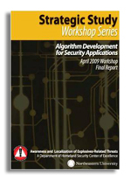
ADSA - Recommendations
ADSA01 Recommendations
  Execute research projects (grant challenges, task orders, initiatives)
  Segmentation first – easiest task
    Begin to learn how to work with 3rd parties
  Reconstruction second
    Difficult to get projection data and parameters
    Difficult to assess results
  ATR third
Recommendations refined at subsequent ADSAs

Slide 7
ADSA – Task Order Linkage

Slide 8
EDS Diagram
X-ray source
+ sensor
Recon
ATR
(segment)
Display
Decision
+ Plane
Threat
Operator

Slide 9
Learned Post ADSA01
Cannot provide to 3rd parties, TSA requirements and data from vendor equipment; cannot test at TSL
  Detection requirements are classified
  Data from deployed equipment are SSI or classified, and are under export control
  DHS/TSA policies do not allow TSL to test components (e.g., an ATR) separate from a complete scanner
  Privacy concerns with scans on AIT equipment.
  Business interests of the vendors should be protected
There was no publicly available set of images that are representative of challenging ATR problems for explosive detection systems.
For EDS, detecting Coke in presence of Pepsi equivalent to detecting explosives in presence of peanut butter
Scan targets (non-threats) on non-security scanner; create project-specific detection requirements
Working with 3rd parties much more difficult than it looks

Slide 10
ATR Project - Bottom Line
Develop automated target recognition (ATR) algorithm to detect targets in scans on a medical CT scanner
Input = 3D CT data + projections
Output = 3D label image (i.e., a “mask”) indicating pixels of detected targets
Targets
  Saline, modeling clay, rubber sheets
Detection of objects in ATRs
  Defined in terms of recall and precision
  Determined using a ground truth label image and automated scoring tools
Scoring of ATRs
  Probability of detection (PD) > 90% (all targets + pseudo target sheets)
  Probability of false alarm (PFA) < 10%

Slide 11
ATR Project - Bottom Line (II)
Prior art methods are proprietary and classified
  Will not know if results are better
Success
  Understanding ATR problem
  Being able to work with vendors in the future
  Solving detecting difficult cases more important than trying to detect easy cases
  Putting database into public domain
Sample ATR, scoring programs supplied to reduce development efforts
Bibliography supplied of prior art

Slide 12
Project Team
ATR developers
  Purdue University: Dong Hye Ye, Charlie Bouman, Pengchong Jin
  Massachusetts General Hospital/Harvard; Synho Do
  University of Tennessee: Jens Gregor
  University of Wisconsin: Jun Zhang, Laura Drake, Hongquan Zuo
  Lawrence Livermore National Laboratory: Philip Top, Ana Paula Sales, Hyojin Kim, Steve Azevedo, Harry Martz
Data collection, database
  Doug Boyd, Sam Song, Tip Partridge, Telesecurity Sciences
  Rick Moore, Alyssa White, Massachusetts General Hospital/ALERT
  Steve Skrzypkowiak, DHS
Tools, ground truth, database
  Franco Rupcich, Independent consultant (PHD with Taly Gilat-Schmidt)
Technical leadership
  David Castanon, Clem Karl, Boston University
  Carl Crawford, Csuptwo
  Harry Martz, Lawrence Livermore National Laboratory
Programmatic leadership
  Michael Silevitch, John Beaty, Ralf Birken, Northeastern University/ALERT

Slide 13
Targets
Saline: ~1035 – 1150 MHU
  3.5%, 10%, 15% concentrations
  Container not part of target; only the saline
Modeling (polymer) clay
Rubber sheets: ¼” thickness (minimum) + other rubber in bags
Minimum mass: 250 g (physical, not CT)
Maximum mass: none
Targets: contiguous

Slide 14
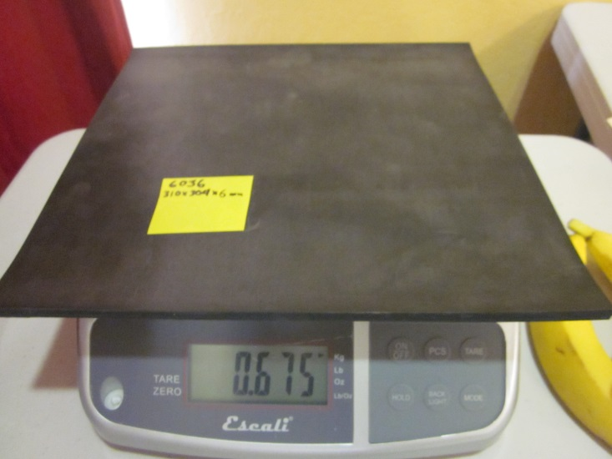
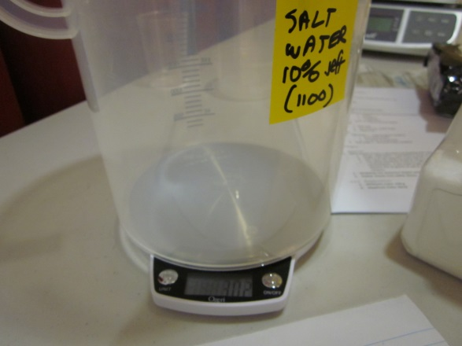
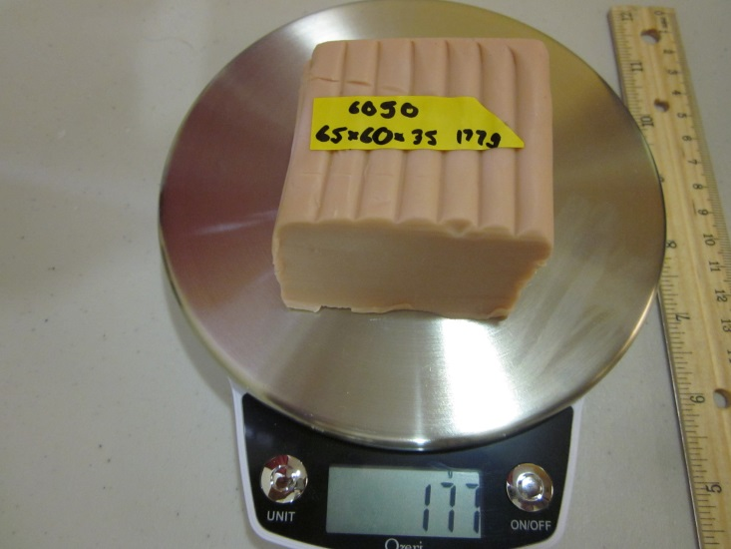
Targets

Slide 15
Pseudo Targets
Used to test lower mass and density thresholds in future
Saline, clay, rubber sheets
  125 g < mass < 250 g
Powders:
  Density < 1 g/cc
  Mass > 125 g
Sheets
  < ¼” thick
Pseudo targets do not count in PD or PFA calculations
  Exception: Required to detect pseudo target sheets

Slide 16
Object Philosophy Issue
Scanned stacks of N rubber sheets
  Is this one object or N separate objects?
Some touching targets merged into one target
  Subjective
  Leads to ceiling/floor on PD/PFA
  Penalize ATR if separated

Slide 17
Non-Targets
Stream of commerce items
  Food
  Drinks
  Electronics
  Magazines
Containers for liquid filled with saline and non-targets (e.g., water)

Slide 18
Packing
Targets packed with different
  Shapes
    Most bulks: saline and clay
    Most sheets: rubber
  Containers
  Concealment
  Clutter
  Location
  Orientation
  Texture
Plastic bins

Slide 19
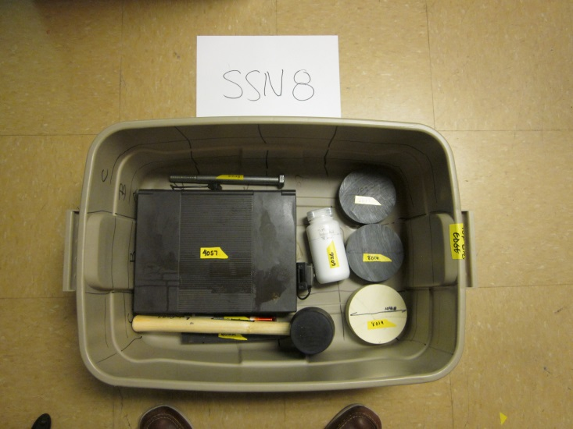
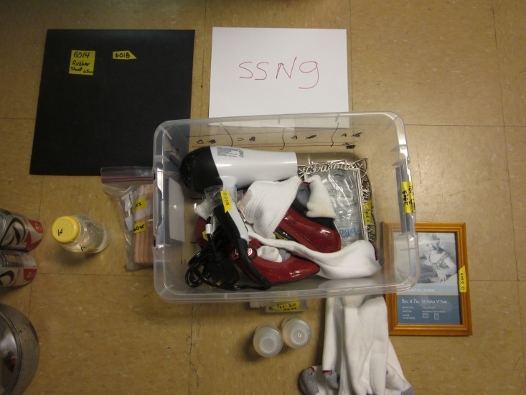
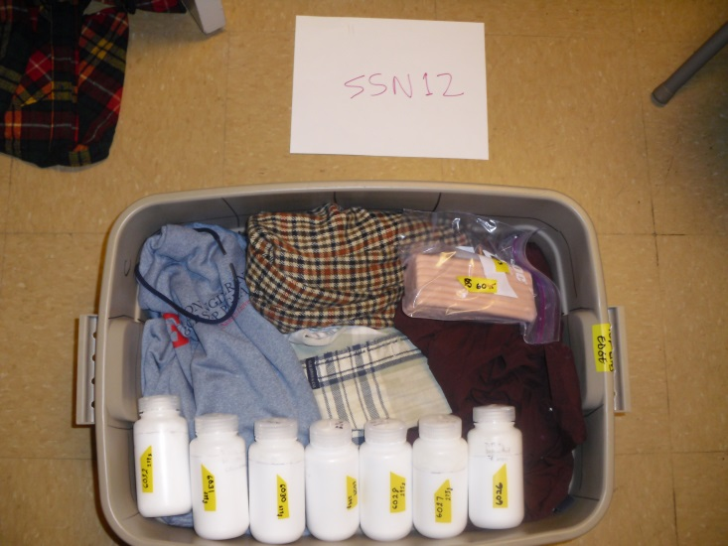
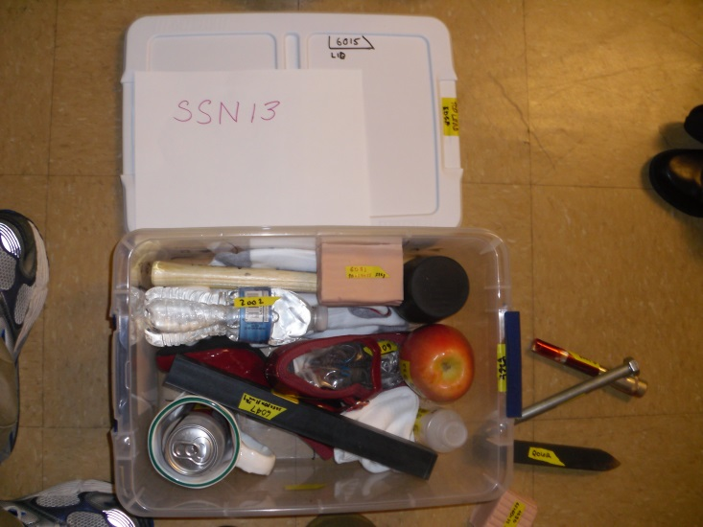
Packing Examples

Slide 20
Level of Difficulty Per Target
High LOD if
  Target is touching a non-target with similar density
  A discontinuous shape was created because of object philosophy. This subjective term means that the target could have been assembled from two more pieces of the base material (saline, rubber and clay).
  Streaks pass through the target
  Low frequency shading (caused by beam hardening and scatter) depress the CT values by more than 10%
  Sausage-like scanned with its long axis contained in the x-y plane.
  Sheet targets scanned with most of its mass contained in the x-y plane.
  Sheets are rolled up
  Texture is present in the target. For example, clay mixed with glass beads.
  High electronic or quantum noise present in the CT images
  Pseudo-target
  Saline with concentration of less than ~7.5 grams of salt / 100 grams of solution
Concentrate on High LOD
Notes:
I will cover in my presentation. delete

Slide 21
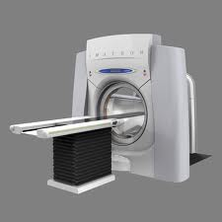
Scanning
Scan on Imatron medical CT scanner
  Same scanner and protocol as reconstruction project
  Single energy
  Raw data collected
~200 scans of bins
407 targets scanned
1371 non-target scanned

Slide 22
The TO3 /TO4 Data Resource Overview
Raw CT Data
Validated Scanner Model
Matching Simulations
The only open access X-ray security resource for third parties
Based on Imatron C300 medical scanner
Mixed mono and dual energy
Scanned data of “security interest” (i.e. not medical)
Validated scanner model
  U. Chicago: Patrick La Riviere, Phillip Vargas
Coupled validated simulation
  Marquette University: Taly Gilat-Schmidt

Slide 23
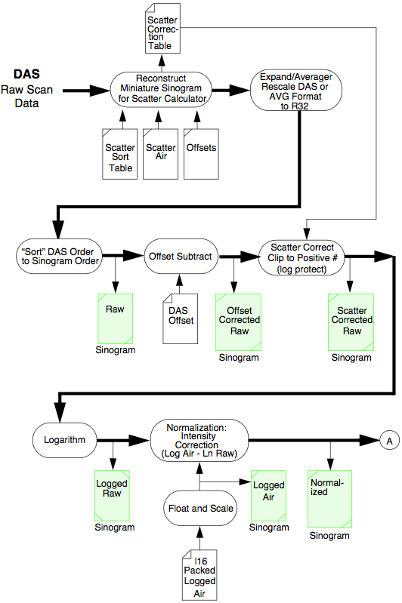
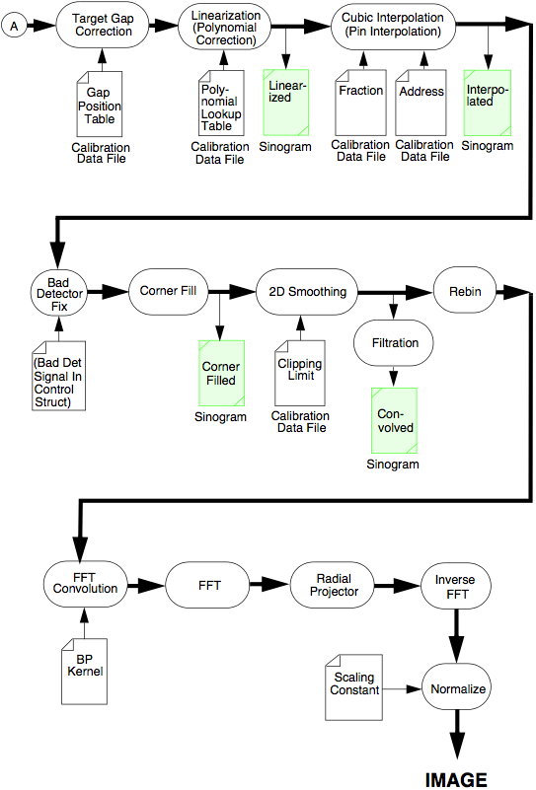

Imatron C300 Data and Software
Access to software processing chain, raw sinogram data products and nominal reconstructions
Examples:
Filled fanbeam
Rebinned parallel
Corresponding projection models
RebinData
Con-volved
Views
FFT Views
Fourier Image
Center
Normal Image

Slide 24
Database
CT scans (~50k images)
Raw data
Ground truth was created only for targets and pseudo targets, not for non-targets
Information on packing
  List of objects and characteristics (mass, size, etc.)
  Pictures – targets, non-targets
  Videos of bins when unpacked
  Objects, bins have IDs

Slide 25
Data Resource Goals
Raw data, images, models, tools, documentation in public domain
  Allow third parties to develop advanced algorithms
All data on FTP site
Available to all researchers after signing agreement with ALERT
  Cannot redistribute data
  Publications/presentations reviewed

Slide 26
ATR Definition
  Input to ATR: 3D CT images + projections
    Objects are not segmented
    Feature are not extracted
    Projections cannot be reconstructed
    Ground truth only to learn about targets
  Possible Functions: segmentation, feature extraction, CT correction, classification
    Not required – could find targets in projections
  Output from ATR: label images, log file

Slide 27
Label Images
Label Image: An image generated either by an ATR or by a ground truth generating program indicating to which label a pixel belongs
Label:
  A set of non-zero pixels in an ATR label image indicating the presence of an alarm at the corresponding location in the physical bag/bin
  A set of non-zero pixels in a ground truth (GT) label image indicating the presence of a target at the corresponding location in the physical bag/bin
The number of pixels in a label image is the same as in its corresponding CT image (Nx512x512)
A label image pixel can be assigned to only one object
Values:
  0 = background
  Label/tag for object for ground truth
  >0 = object number from ATR
    Does not have to match object tag

Slide 28
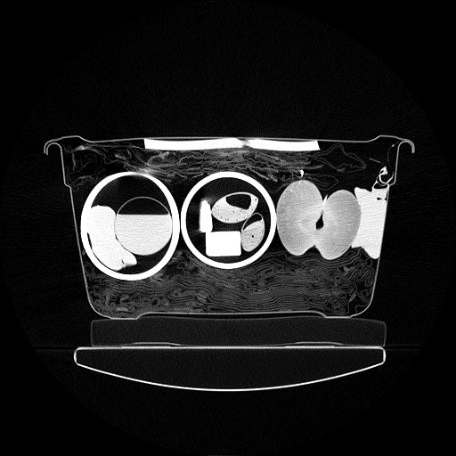

Ground Truth
Label images showing locations of targets
Used for
  Target analysis (feature extraction) by researchers
  Automated scoring
More in Franco’s talk

Slide 29
ATR Implementation
Sample ATR supplied based on Karimi’s code for Segmentation Project
  Demonstrate reading FITS images, writing label images and log files
  Can rip out algorithm and insert your own
  C/Linux
Do not over-train on the data or use illegal features
Execution time out of scope

Slide 30
ATR Overview (Prior Art)
Multi-Path
Segmentation
Feature
Extraction
CT
Correction
Classifier
Sheet filter/path
Bulk filter/path
Weapons filter/path
Mass
Density
Z-effective
Texture
Volume
Non-linear
thresholds
Orientation
Resolution
Do something other than prior art
Notes:
30

Slide 31
Features (Prior Art)
Mass
Mean: LAC, Zeff
Standard deviation: LAC, Zeff
Histograms
Higher-order moments
  Skew, kurtosis, entropy
Texture
  Wavelets
Your responsibility to determine relevant features

Slide 32
Illegal Features
Shape (except for minimum sheet thickness)
  Can be used for separate paths
Size
Orientation
Location
Maximum mass, volume
Container type
Will review your features during course of the project

Slide 33
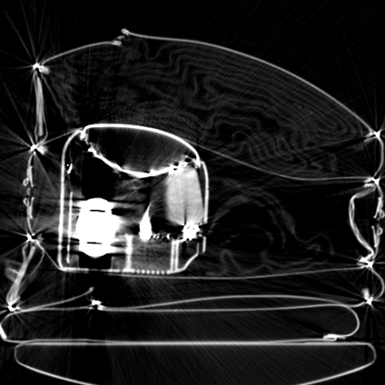
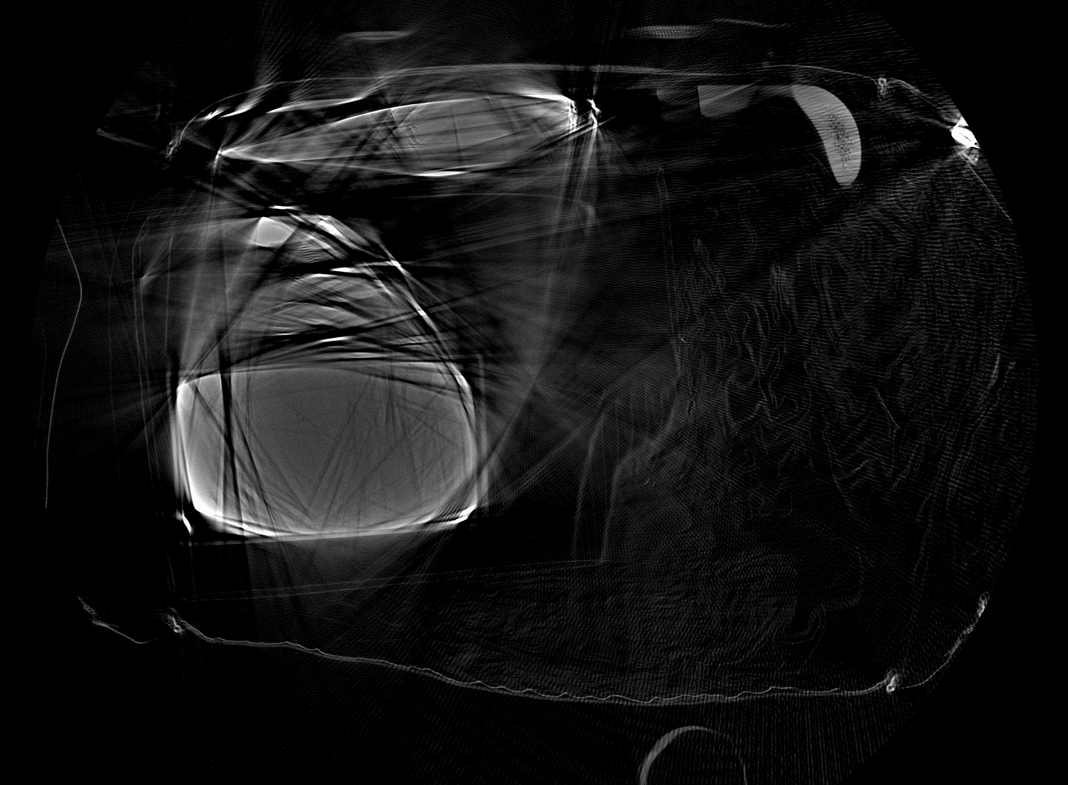
Typical Image Quality
Artifact types
  Shading
  Streaks
  Noise
  Blurring
  Rings
Artifacts lead to
  Merging of objects
  Splitting of objects
  Imprecise density, volume, mass, shape
How are IQ issues handled in ATR?

Slide 34
ATR Testing
Run by performer at their site
  Too difficult to execute at ALERT
  Honor system not to over-train
Results scored by provided tools
  PD/PFA
  Some indication of difficult cases

Slide 35
Performance Metrics
PD > 90%, PFA < 10%
  All targets
  Pseudo target sheets
  Concentrate on high LOD cases
PD = # targets detected / # targets scanned
PFA = # false alarm objects / # non-targets scanned
Detection based on recall/precision

Slide 36
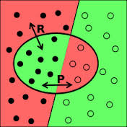
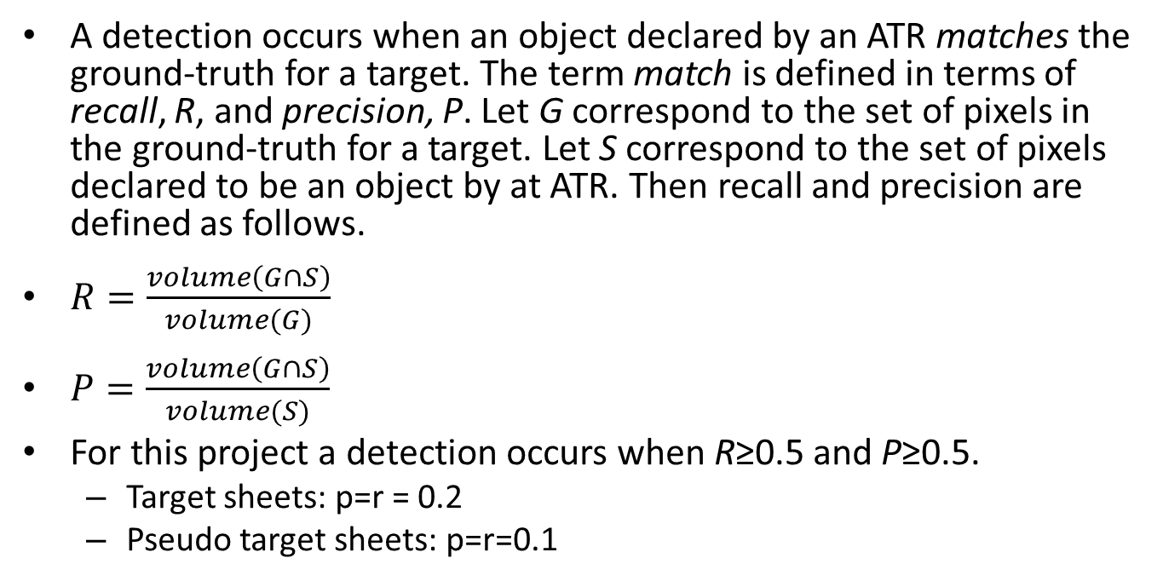
Detection and False Alarm
A detection occurs when an object declared by an ATR matches the ground-truth for a target. The term match is defined in terms of recall, R, and precision, P. Let G correspond to the set of pixels in the ground-truth for a target. Let S correspond to the set of pixels declared to be an object by at ATR. Then recall and precision are defined as follows.
$R=\frac{volume\left(G∩S\right)}{volume(G)}$
$P=\frac{volume\left(G∩S\right)}{volume(S)}$
For this project a detection occurs when R≥0.5 and P≥0.5.
  Target sheets: p=r = 0.2
  Pseudo target sheets: p=r=0.1
In this figure the relevant items are to the left of the straight line while the retrieved items are within the oval. The red regions represent errors. On the left these are the relevant items not retrieved (false negatives), while on the right they are the retrieved items that are not relevant (false positives).

Slide 37
More Performance Criteria
Minimize use of special cases (corner cases)
Feature space chopped up
  Over-training
Extensible for new targets

Slide 38
Support Functions (Tools)
Franco Rupcich coding in C
Sample ATR
  Reading image
  Writing results (label, log files)
  Revised as necessary
  Replace ATR functions with your own
Scoring software
  Detection using recall/precision
  PD/PFA
Simulated images for validation
Image conversion to FITS
Ground truth - Mevislab

Slide 39
Block Diagram

Slide 40
Program Success
The program will improve ATRs. The improved target recognition may lead to decreased minimum target mass, increased target population coverage, increased probability of detection and decreased probability of false alarm.
The program will increase involvement of third parties via the availability of common CT datasets, and tools, which will increase the work in target recognition, and the number of students who can join the workforce of the vendors and DHS.
The program will foster collaboration between academics, national laboratory personnel and incumbent security industry vendors.
Allow scientific method to work:
  The chief characteristic which distinguishes the scientific method from other methods of acquiring knowledge is that scientists seek to let reality speak for itself, supporting a theory when a theory's predictions are confirmed and challenging a theory when its predictions prove false.

Slide 41
Uniqueness
Bibliography and copies prior art provided
  Patents, presentations, reports, articles
  Vendors may be doing something else
Do not replicate prior art
Extend sample ATR

Slide 42
Collaboration
Researchers encouraged to collaborate with other team members
  Tools, image formats
  Not on algorithms
Segmentation expertise from segmentation project

Slide 43
Out of Scope
Execution speed + computational expense
Equating to performance of equipment deployed by TSA
Reconstructing CT projection data; do not want to re-run the Reconstruction Project (Task Order 3).

Slide 44
Publications/Patents
Publications permitted and encouraged
Prior review required by ALERT
  Process denoted REAP
  Use “leads to higher false alarms”
  Do not say “cannot detect”
May obtain patents on work

Slide 45
Furnished to ATR Developers
Specifications
  Technical top-level
  Tools – scoring, sample ATR
  Scanning
Database
  CT images
  Ground truth labels
  Sample ATR
Code
  Automatic scoring
  Sample ATR
Access to subject matter experts

Slide 46
Performer Future
Developing vendor-neutral ATRs
Working with vendors
Work on other modalities
Prediction of detection capability of future scanners

Slide 47
Data share access
Data Resource warehoused on networked BU server
  Raw data, reconstruction software, documentation, scanner models, simulations
Process for obtaining data
  Request NDA from ALERT
  Obtain account to access network data share site
  Must agree to have publications reviewed (“REAP’ed”) for problematic wording
Access to data is available after project ends
Researcher results & documentation can be posted as well

Slide 48
Differences from TSL Certification
Saline, clay, rubber, not explosives
Medical CT scanner
Bins, not bags
PD/PFA per object type, not per bag
Comingled PD/PFA runs
  Missed detection can lead to false alarm because of recall/precision
Automated scoring with recall/precision
Testing open, not blind
Statistical relevance not an issue

Slide 49
Feedback
Vendor panel
Questionnaire for all participants
  www.surveymonkey.com/s/TaskOrder4
Specifications, results online
  https://myfiles.neu.edu/groups/ALERT/strategic_studies/TaskOrder04/
David Lieblich Kam Lin Wong David Perticone James Connelly Carl Bosch Ling Tang Piero Landolfi Christopher Gregory | Analogic Reveal L-3 Communications IDSS Surescan Rapiscan Morpho Detection Smith Detection

Slide 50
Acknowledgements
Laura Parker, DHS, funding
Vendor feedback
  In particular, Matthew Merzbacher, Morpho Detection
Jeffrey Kallman, Steve Azevedo, LLNL, technical support
Heartscan, South San Francisco, Imatron scanner
ALERT staff
  Melanie Smith(**), Teri Incampo, Kristin Hicks, Deanna Beirne, Anne Magrath

Slide 51
Super Special Acknowledgements
The ATR initiative would not have been a success without the research groups. The success of this project is due 99.99% to their contributions.
We extend our heartfelt thanks to them for their participation and working the project team to fix issues when they became evident.

Slide 52
Indemnification
All problems, issues and bugs are the responsibility of Carl Crawford, Clem Karl and Harry Martz, not the researchers and support staff
ATR presentations have uniform format and content in order to make it easier for the audience to understand the ATRs
  Format may have bugs - TBD

Slide 53
So What? Who Cares?
So What? … What was done …
  Five ATRs developed: PD ~ 90%, PFA ~10%
    Targets: saline, modeling clay, rubber sheets
    Scanning: Medical CT; 500 target scans
  Automating scoring tools developed
    Ground-truth labels - semi-automatically
    Standardized reports
  All of the above in public domain
Who cares?... To be determined by you if true …
  Problem maps to security scanners
  ATRs novel with respect to literature in public domain
  Researchers available to contract to vendors
  Students trained to work in industry
  Third parties can work on unclassified, relevant projects
  Scientific method can be applied for more improvements

Slide 54
BACKUP SLIDES

Slide 55
Questions for panel
Questions for participants

