Slide 1
ATR Project (Task Order 4) Program Review Database, Ground Truth, & Software Tools
Franco Rupcich, PhD
6 November 2014

Slide 2
Conclusions
So What?
Who Cares?
GT Labeling
gen_pdpfa.sh
Tools make ATR development easier
Database, ground truth, and software tools available in the public domain and can be leveraged for future projects
Everything available on FTP site
CT Images
ATR/satr
MeVisLab
ATR Label Images
Automated Standardized Reporting
GT Label Images
Automated Scoring Tools
PD/PFA Log Files
TO4 Database
Database
File
Software
Notes:
Ground Truth Development and Label Images
Semi-automated segmentation program for creating GT label images from CT images
GT label images available for all TO4 CT images (188 total)
Automated Scoring Tools
Offload development of scoring tools from researchers
Provide consistent method of scoring across ATRs
Provide consistent reporting via generated log files
Facilitate improvement of ATR performance
Tweaking of scoring parameters (precision, recall)
Useful information in log files
Reporting of incomplete detections

Slide 3
Biography
Education (Marquette University, Milwaukee, WI)
PhD, Biomedical Engineering
Research
Radiation dose reduction in medical CT
Objective image quality metrics
Energy-resolved CT
Career
Lead CT Systems Engineer at GE Healthcare (Waukesha, WI)

Slide 4
TO4 Database
Excel workbook describing
Objects (mass, material, target type, etc.)
Packing/Scanning (objects in each SSN, location, orientation, etc.)
Includes packing videos and pictures of targets
Available on FTP site

Slide 5
Object Database
Worksheet in Excel containing info for each object
Type
Sub-type
Form
Dimensions
Mass

Slide 6
Packing Database
Worksheet in Excel containing info for each object in each scan
Object IDs
Boundary box of each target/pseudo-target
Level of Difficulty of each target/pseudo-target
Object database info for each object

Slide 7
GT Labeling Overview
Purpose
GT label images required as reference against which performance of an ATR can be scored
Methods
Each GT label image was created via semi-automated segmentation and masking of each target in each CT image
All GT label images and source code available on FTP site
CT Image
MeVisLab
GT Label Image
Database

Slide 8
GT Labeling Methods
MeVisLab
Image processing modules readily available
Semi-automated segmentation
Interpolation of contours across slices
Region growing
Masking
Semi-automated labeling program already developed by Seemeen Karimi for TO1 and modified for TO4

Slide 9
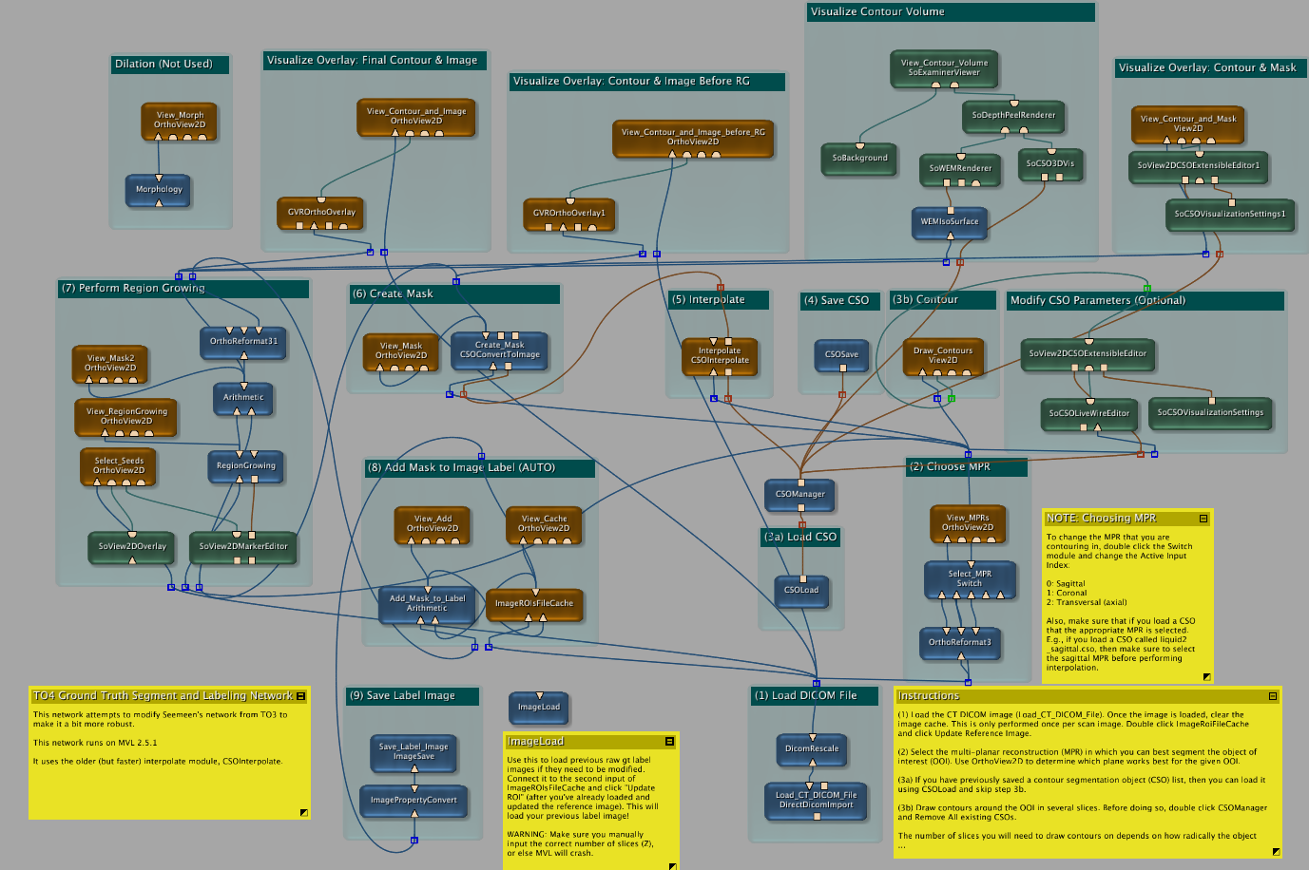
GT Labeling in MeVisLab
Notes:
Laugh/smile when you show this.

Slide 10
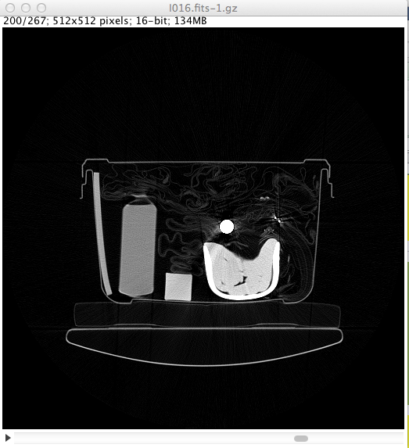
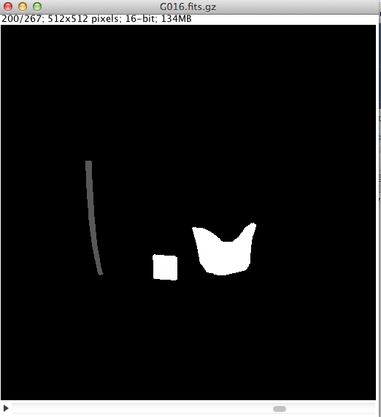
GT Label
INPUT: CT Image
OUTPUT: GT Label Image
Rubber sheet
Coke bottle
Rubber rod
Clay
Green = target
Red = non-target
SSN 16, Slice 200 shown

Slide 11
GT Labeling Issues
MeVisLab often crashes during interpolation step
SOLUTION: draw more contours for targets that change radically between slices
Thin sheets are difficult to segment
SOLUTION: reduced P/R specs for thin PT sheets
CT artifacts make segmenting difficult
SOLUTION: segment target in many slices
Time-consuming
~20-40 minutes per bag
Notes:
Bulk 0.5
T Sheet 0.2
PT Sheet 0.1
Say that r/p lowered for sheets (t + pt)
Discuss merging of some targets – (9 merged targets – saline, clay, rubber). – currently ATR is punished if it separates the merged targets successfully.
Discuss other pieces of rubber (eg, mallet) – non-targets because density is much higher than rubber sheets

Slide 12
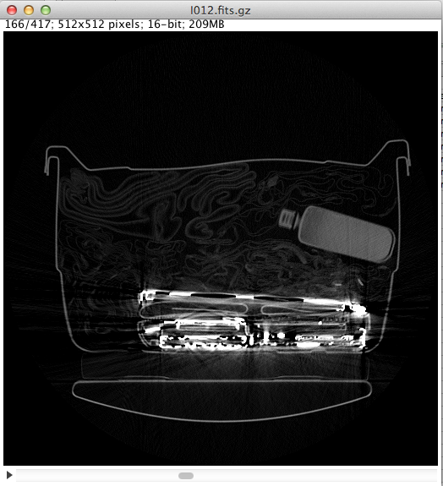
GT Labeling Issues: Thin Sheets
CT Image
GT Label Image
Two ~1.6mm rubber sheets
SSN 12, Slice 166 shown
Notes:
FJR Notes:
Explain reduced P/R for thin sheets

Slide 13
Automated Scoring Tools Overview
Workflow
Run ATR/satr on CT images to produce label images
Score label images against GT
Generate PD/PFA statistics
Software code
written in C or Bash shell script
runs on Mac OS X and 32-/64-bit Linux
available on FTP site
Researchers ran code at their respective sites

Slide 14
Sample ATR (satr)
Performs erosion and CCL on CT image
Calculates the mass of objects and has a classifier based only on mass and density
Outputs label image and log file
Served as basis for ATR code (file I/O, log files, etc.)
Notes
Code originally written by Seemeen Karimi and modified by Carl Crawford and Franco Rupcich for TO4
Can be used by researchers as basis of their ATR
CT/g3d Image
ATR/satr
ATR Label Image

Slide 15
gen_pdpfa.sh
Runs an ATR/satr on a set of CT images to produce label images
Scores the label images against GT
Generates log files containing PD/PFA statistics
gen_pdpfa.sh
CT/g3d Images
ATR/satr
ATR Label Images
GT Label Images
Automated Scoring Tools
PD/PFA Log Files
Database

Slide 16
gen_pdpfa.sh Log Files
pdpfa pds log file [.xls]
PD/PFA statistics
pdpfa summary log file [.txt]
summary PD/PFA information
pdpfa detections log file [.xls]
indicates whether each target was detected or missed
pdpfa false alarm log file [.xls]
information for each false alarm produced
Log file used by researchers to report PD/PFA

Slide 17
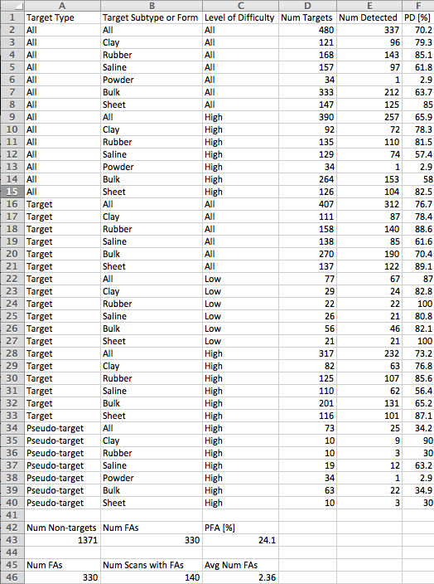
Log File: pdpfa_log_pds.xls
PD info based on
Type
Subtype
Form
LOD
PFA info
PFA
Average number false alarms

Slide 18
Other Work
Specifications documents (available on FTP site)
Top-Level Spec - high-level specs for TO4 project
SW Tools spec - detailed specs for each SW tool
Level-of-difficulty – specs for LOD classifications (Low, High)
LOD Assignments
Worked with Stephen Skrzypkowiak to verify all LOD assignments
gtver
Program to verify integrity of GT labels against database
g3d test images
Two test images and corresponding GT label images are available
More can be created upon request

Slide 19
Lessons Learned
Scanning and Database creation
Record as much information during scan-time as possible
Revise data collection procedure based on “Lessons Learned” from collecting and using sample data first
Precisely defining requirements up-front saves time later
Changing GT labels
Changing code
Object philosophy
GT labeling
Could be small project in and of itself
Future consideration: create GUI using ITK/VTK C++ tools with image processing modules catered specifically toward future TO projects...?

Slide 20
Future
Database, GT labeling program, and automated scoring tools may be useful for future DHS and TSA projects
AT2
AIT
Cargo applications

Slide 21
Questions?

Slide 22
Backup slides

Slide 23
Label Images
3D image that indicates if a pixel in a CT image corresponds to a target
Output from
Ground Truth generating program (Ground Truth Label Image
ATR program (Label Image)
Notes:
Fjr notes
Delete?

Slide 24
Precision and Recall
Precision
The fraction of a label declared by an ATR that overlaps with a target as declared by in the ground truth label image
Recall
The fraction of a target, as declared in the ground truth label image, that overlaps with a label detected by an ATR

Slide 25
Detection, Miss, and False Alarm
A detection occurs when an alarm declared by an ATR matches the ground-truth for a target. The term match is defined in terms of recall, R, and precision, P
A false alarm occurs when an ATR creates a label that does not match the requirements for a detection
A miss occurs when an ATR produces no label that satisfies the precision and recall specifications for a target in the ground truth label image

Slide 26
Incomplete Detections
A detection that occurs for the values of precision and recall multiplied by the factor, alpha
The default value of alpha is 0.0.
This implies that an ATR label that intersects a GT label by at least one pixel meets the requirement for an incomplete detection.
If an ATR label meets the requirements for a detection for a GT label, then it will not be counted as an incomplete detection for that GT label
Note the following:
Incomplete detections do not count as a detection
Incomplete detections do count as false alarms
ATR labels that generate incomplete detections can be found under the “False Alarms” section of the dder Summary Log File, as well as in the dder False Alarms Log File.
Any false alarms that have “intersecting GT labels” reported are incomplete detections

Slide 27
Incomplete Detections
Implemented to help identify ATR labels that overlap GT labels but do not fully meet precision/recall specs for a detection
May lead to clues to help increase PD or decrease PFA

Slide 28
TO4 Database
Excel workbook containing information about all objects and SSNs for the TO4 project
/eng_research_TO4/database/to4 database v30.xlsx
Object Database -- “objects” sheet in the Excel file
Packing Database -- “Packing” sheet in the Excel file
Height Database -- “Scan info” sheet in the Excel file
SSN Filtering -- “SSN Filter” sheet in the Excel file
Allows filtering of SSNs based on contents
Type
Sub-type
Form
LOD
NOTE
satr, dder, and pdpfa use .csv versions of these databases, which are version controlled and bundled with each release of the tools
NOTE
The height database is used only by satr to zero out the patient table

Slide 29
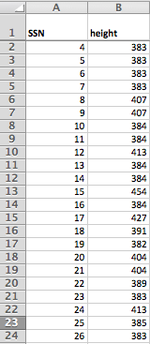
Height Database
Contains height of patient table for each SSN
Used by satr to zero out patient table in CT image to avoid false alarms

Slide 30
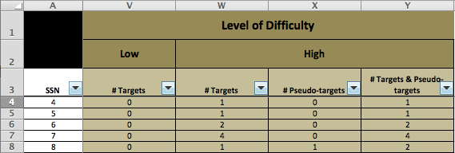
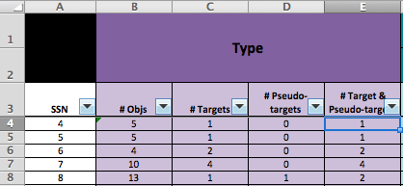
TO4 Database: SSN Filtering
Find SSNs that contain specified
# targets/pseudo-targets
# targets/pseudo-targets of certain sub-type
# targets/pseudo-targets of certain form
# targets/pseudo-targets of certain LOD
Any combination of the above
Can be used to help create desired subsets of SSNs, for example:
SSNs with > 0 pseudo-targets
SSNs with > 0 targets/pt with high LOD
SSNs with > 0 rubber sheet targets with high LOD

Slide 31
Block Diagrams: ATR/satr, dder, pdpfa
CT/g3d Images
ATR/satr
ATR Label Images
ATR Label Images
GT Label Images
dder
dder Log Files
Database
Dder log files
pdpfa
pdpfa Log Files
Database

Slide 32
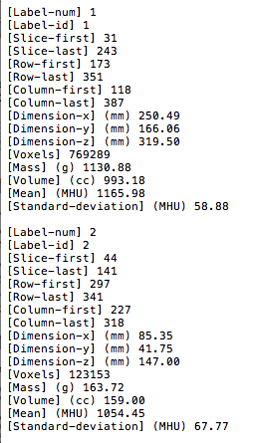
Log File: satr_log.txt
Info about labels produced by SATR
Label IDs
Locations
Dimensions
# of voxels
Mass
Volume
Mean
Stdev

Slide 33
Detection Determination Scoring (dder)
Synopsis
scores an input label image produced by an ATR against the corresponding GT image based on specified values of precision and recall
writes results to two log files
Input Files
ATR label image [.fits.gz]
GT label image [.fits.gz]
Object database file [.csv]
Packing database file [.csv]
Output Files
dder summary log file [.txt] summary scoring information
dder false alarm log file [.xls] information for each false alarm

Slide 34
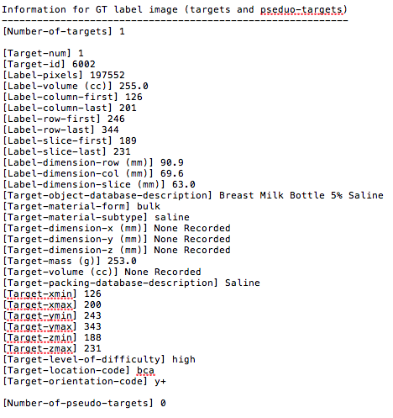
Log File: dder_log_summary.txt
Summary scoring info for a single SSN
Info for each target in GT label image
Info for each label in ATR label image
Scoring info
Detections
False alarms
Misses
NOTE: This file is read by pdpfa to compile scoring info across SSNs for calculating PD/PFA

Slide 35
Log File: dder_false_alarms.xls
Info about each false alarm produced by the ATR for the given SSN
Label ID of false alarm
Intersecting target IDs (if any)
Form and subtype of intersecting targets
Precision/Recall of intersecting targets
NOTE: This file is read by pdpfa to compile overall false alarm info across SSNs

Slide 36
PD/PFA Scoring (pdpfa)
Synopsis
compiles the results from a specified set of images that have been scored using dder
determines PD and PFA statistics
writes results to four log files
Input Files
List of log files output from dder [.txt]
Object database file [.csv]
Packing database file [.csv]
Output Files
pdpfa summary log file [.txt] summary PD/PFA information
pdpfa detections log file [.xls] indicates whether each target was detected or missed
pdpfa pds log file [.xls] PD/PFA statistics
pdpfa false alarm log file [.xls] information for each false alarm produced

Slide 37
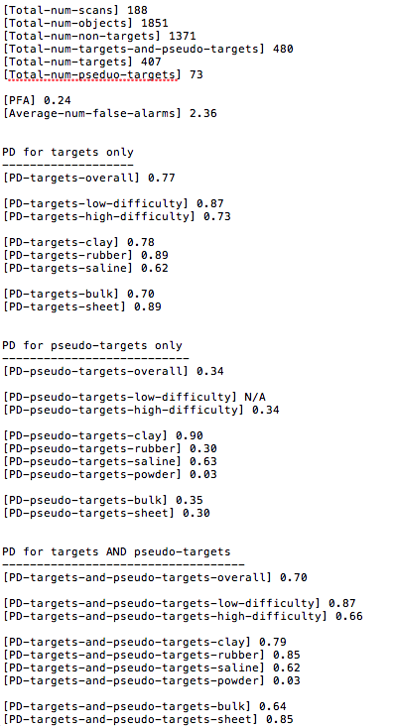
Log File: pdpfa_log_summary.txt
Summary PD/PFA info
PD for targets only
PD for pseudo-targets only
PD for targets and pseudo-targets
PFA
Average number false alarms

Slide 38
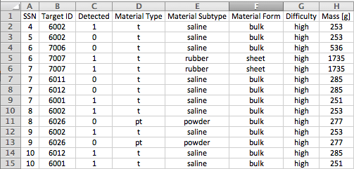
Log File: pdpfa_log_detections.xls
Indicates whether each target/pseudo-target was detected

Slide 39
Log File: pdpfa_log_false_alarms.xls
Info about each false alarm produced by the ATR
Label ID of false alarm
Intersecting target IDs (if any)
Form and subtype of intersecting targets
Precision/Recall of intersecting targets

Slide 40
Log File: pdpfa_log_pds.xls
PD info based on
Type
Subtype
Form
LOD
PFA info
PFA
Average number false alarms

Slide 41
Gen_pdpfa
Synopsis
Runs a specified ATR on a specified set of CT images to produce a set of corresponding label images
Scores the label images against the ground truth (GT) label images using dder
Generates PD/PFA statistics using pdpfa
Input Files
CT image(s) [.fits.gz]
GT image(s) [.fits.gz]
Label image(s) [.fits.gz]
Object database file [.csv]
Packing database file [.csv]
Height Database file [.csv]
List of SSNs for which to calculate PD and PFA statistics
Output Files
All log files generated by satr, dder, and pdpfa
dder log list file [.txt] list of dder log files used by pdpfa to compile results
gen_pdpfa.sh log file [.txt] standard output from satr, dder, and pdpfa

Slide 42
g3d Test Images
Two test images and corresponding GT label images are available
One w/ bulk targets, one w/ sheet targets
All objects have realistic MHU values
Test images & documentation located on FTP site:
eng_research_TO4/test_images

Slide 43
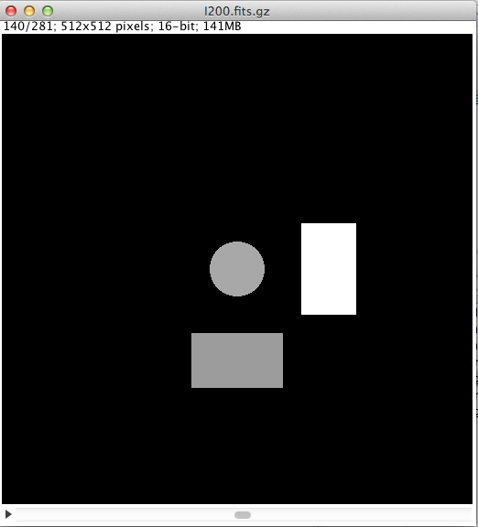
g3d Test Image 1
CT Image (I200.fits.gz)
GT Label Image (G200.fits.gz)
Bulk Target
Clay (1640 MHU)
Bulk Target
Saline (1080 MHU)
Non-target
Water (1000 MHU)
Slice 140 of 281
Slice 140 of 281

Slide 44
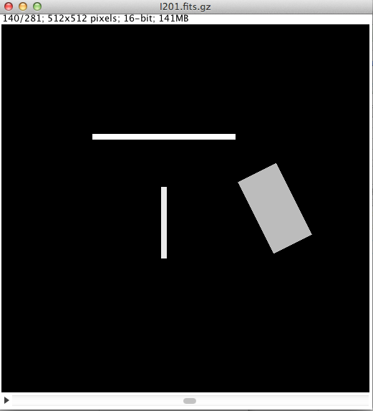
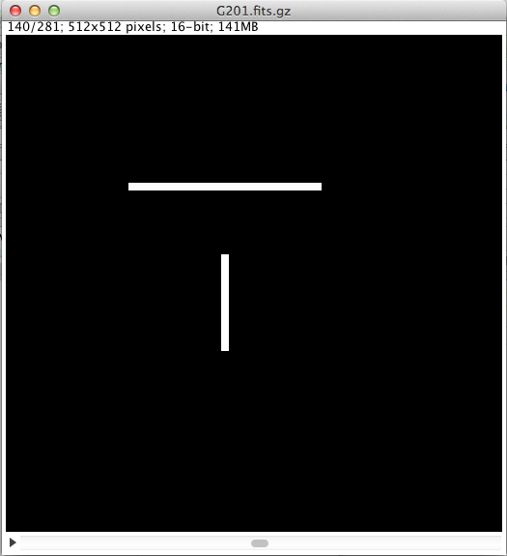
g3d Test Image 2
CT Image (I201.fits.gz)
GT Label Image (G201.fits.gz)
Sheet Target
Rubber (1361 MHU)
0.34” (8.62mm)
Sheet Target
Rubber (1252 MHU)
0.30” (7.54mm)
Non-target
Water (1000 MHU)
Slice 140 of 281
Slice 140 of 281

Slide 45
Conclusions
TO4 Database
Excel spreadsheet created during scanning
Detailed information for all scanned objects and SSNs
Ground Truth Development and Label Images
Semi-automated segmentation program for creating GT label images from CT images
GT label images available for all TO4 CT images (188 total)

Slide 46
Conclusions
Automated Scoring Tools
Offload development of scoring tools from researchers
Provide consistent method of scoring across ATRs
PD/PFA
Provide consistent reporting via generated log files
Overall PD/PFA
PD per type, sub-type, form, and LOD
Detection status for each target/pseudo-target
Facilitate improvement of ATR performance
Tweaking of scoring parameters (precision, recall)
Useful information in log files
Reporting of incomplete detections

Slide 47
Conclusions
GT Labeling
Automated Scoring Tools (gen_pdpfa.sh)
CT Images
ATR/satr
ATR Label Images
MeVisLab
GT Label Images
dder
dder Log Files
TO4 Database
Database
Standardized Reporting
pdpfa
PD/PFA Log Files
Notes:
Delete dder and pdpfa at least for this figure.

